Slide 1
One is the Loneliest Number
Linda Gossar-Loesch
https://www.bing.com/videos/search?q=&view=detail&mmscn=mysv&mid=C0623A591B6C5C1AAD46C0623A591B6C5C1AAD46&FORM=SVIM01

Slide 2
This Photo by Unknown Author is licensed under CC BY-NC-ND

Slide 3
Media and Loneliness
Music
One Is the Loneliest Number
All By Myself
Only the Lonely
Movies
The Martian
Wall-e
Solaris

Slide 4
What is loneliness?
A universal human emotion that is both complex and unique to each individual.

Slide 5
Age of Loneliness
Lack of connection or communication with other beings.
Loneliest groups in America?
1.
2.

Slide 6
Dr. John Cacioppo, expert on loneliness
Loneliness is linked to genetics
Situational variables
1. physical isolation
2. moving to another area
3. divorce
4. death of significant person

Slide 7
Common causes of Loneliness
1. Life events that we just mentioned
2. Chronic depression
3. Birth of a child
4. Marriage
5. Socially disruptive event –moving
6. Unstable marriage
7. Social phenomenon – spreading from one to another

Slide 8
Feeling Lonely verses Social Isolation
Feeling lonely – person needs social interaction that is currently not available
Social Isolation – Being alone and not being lonely even though there is no one around.

Slide 9
Surprising benefits of solitude
Improve cognitive state
Improve concentration
Increase moods
Positive growth experiences
Religious experiences
Positive identity building
Creative process

Slide 10
Loneliness and Modernization
Negatives:
People moving away and relocating
Households shrink in size
Media usage increases
Positives:
More opportunities for people
More choices in family size
Better access to information

Slide 11
Loneliest country in the world
Loneliness increased in two groups:
Seniors
People living in low density suburbs
Americans seem to report more loneliness than any other country

Slide 12
Internet – Pros
Pros:
Lonely people use the internet to keep in touch
Internet usage decreased loneliness and depression significantly
Social support and self esteem was also increased.
Gives a sense of freedom and control
Positive impact on well being or happiness

Slide 13
Internet - Cons
Internet users are lonelier
People trying to make friends become lonelier

Slide 14
What are the health risks associated with loneliness?
Mental
Physical
Social

Slide 15
Pop Quiz – Which Category?
Depression and Suicide | Poor Decision making
Cardiovascular disease and stroke | Alcoholism and drug abuse
Increased stress level | The progression of Alzheimer’s disease
Decreased memory and learning | Altered brain function
Antisocial behavior

Slide 16
Mental
Depression and Suicide
Schizoid character type
Mental health problems
Anxiety
Pessimistic feelings about their ability to succeed

Slide 17
Social Issues
Antisocial behavior and self destructive behavior
Hostile and delinquent behavior
Negative impact of learning and memory
Increased chance of premature death

Slide 18
Physical changes
Disrupts the regulation of cellular processes deep in the body.
Increase levels of Cortisol levels
Impaired cellular immunity
Higher antibody titers to the Epstein-Barr Virus and human herpes viruses
Increased level of Interleukin
Stronger Inflammatory responses to acute stress that is a risk factor for age related diseases

Slide 19
Loneliness a higher risk killer that obesity
Social Isolation and feelings of loneliness increase a person’s chance of premature death by 14% - nearly double the risk of early death from obesity

Slide 20
Remedies for loneliness
Less Social Media and technology
More outdoor time
Contact a friend or family member in a non digital way
Share your living space
Don’t work too hard
Avoid binge watching TV
Get a pet
Volunteer
Watch a movie

Slide 21
Remedies
Start a gratitude journal
Create something new

Slide 22
Loneliness in the Elderly
Children live more than an hour away
Elderly that live alone had less face to face contact with someone
Problems of mobility
Lack of friends their own age
Lack of community participation

Slide 23
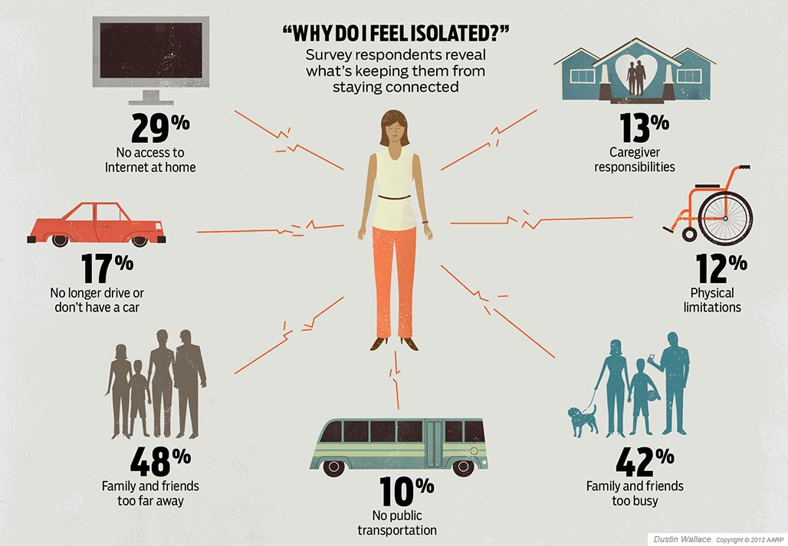

Slide 24
Risk factors for the elderly
Women are more likely to experience loneliness
The older the person the greater change they are lonely
A person who lives alone
Poor economic situation
Poor outlook on health
Infrequent contact with relatives and friends
Adult children not living in close proximity
Not able to use modern communications – facebook, e-mail, skype

Slide 25
How Activities can help
Help residents to skype with family members who are not close by
Develop activities for room bound resident to do
Daily exercise program
See each room-bound resident daily with a 5 minute visit
Encourage residents to pursue a hobby - old or new
Provide additional visitors through volunteers
Take residents that are able to go on outings
Encourage family get togethers by providing a space for them when they are in town

Slide 26
The Loneliness Quiz
Mark your answers:
Never
Rarely
Sometimes
Often

Slide 27
The Loneliness Quiz
1. How often do you feel unhappy doing so many things alone?
2. How often do you feel you have nobody to talk to?
3. How often do you feel you cannot tolerate being so alone?
4. How often do you feel as if nobody really understands you?
5. How often do you find yourself waiting for people to call or write?

Slide 28
Loneliness Quiz
6. How often do you feel completely alone?
7. How often do you feel you are unable to reach out and communicate with those around you?
8. How often do you eel starved for company?
9. How often do you feel it is difficult for you to make friends?
10. How often do you feel shut-out and excluded by others?

Slide 29
Scoring
Never – 1
Rarely – 2
Sometimes – 3
Often – 4
Total all points

Slide 30
Scoring Key
30 and up Extreme Loneliness
22 – 29 Moderate Loneliness
15 – 21 Normal Loneliness
0 – 14 Little to No Loneliness

