Slide 1
Placing Aging, Ailing Parents
A Childs’ Perspective
(A Child Who Is an Activity Director that is)

Slide 2
My Observations--3 Workshops /3 Years all some how or another connected to Change
1.The 3 R’s Routines, Rituals, Reminiscing - Challenges with Change
2. Creating Our Life - About Identity and what changes about our identity and what stays the same throughout our lifetimes
3. Placing Aging and Ailing Parents- Forced Change/Struggling with Change
Does anyone think I might have an obsession with change?

Slide 3
The Thing is the only thing certain in life is CHANGE
THINGS CAN CHANGE IN THE BLINK OF AN EYE
IN A SPLIT SECOND
THAT’S ALL IT TAKES
This Photo by Unknown Author is licensed under CC BY-NC-ND

Slide 4
Placing Aging/Ailing Parents… A Childs Perspective
Developed out of my own personal experiences in living with the Physical, Emotional, Mental, and Spiritual Drain that Placing my parents and all that has gone with that experience has caused.
Basically it is yet another workshop about change and how comfortable or not comfortable people in general are with it.
Why is this Important to the Activity Professional?
ANY THOUGHTS?

Slide 5
Facility Staff will be dealing with the Fallout the family and possible future resident feels about having to seek placement. How we are perceived by the family/ “resident”, their first impression of us, will set us apart from the
rest.
Something to ponder, First Impressions.

Slide 6
THE Incident………………………….
Father falls down basement stairs and breaks hip Friday before Christmas. Mom is confused and cannot see well. Dad lays on floor for 3 hours until son calls, mom screams 911 dispatched. Dad is Mom’s main Care Giver so Mom cannot be left at home alone. Children step in. Next day, Dad has surgery. After surgery and a few days in the hospital Dad is sent to rehab. Mom goes with/ for Respite stay. They both move to Assisted Living connected to Rehab., but it is too expensive. The Search Begins for other placement…………………………………….

Slide 7
Searching for the Right Facility Match
Welcome to PAPA Family Feud
We Surveyed 100 Families and Residents (not really) and the top 6 Answers are on the board.
When searching for the right facility match what are the things that you consider/amenities that you would like the facility to have?

Slide 8
1. Financial Manageability (you do end up having to look into parent(s) financial affairs)
4. Location to Family Easily Accessible
5. Good Food
2. Great Care
3. Available Activities
6. Doctor Visits in the Building

Slide 9
Questions to Ask while Touring Facility
If you could ask one question while touring a facility that you were going to place a parent or a family member what would that question be?

Slide 10
Questions to Ask While Touring a Facility
Here are some Questions I asked:
Staff to Resident Ratio’s on Each Shift
How Many Showers per week
How Many laundry days per week
Medication Management
Fall Prevention Tactics
MD Visit in the Building
Wound Care/Body Checks
Most Importantly All About ACTIVITIES!!!!!!!!!!!!!!!!!!!!!!!
Base Price of Room/Levels of Care-ADD ONS

Slide 11
IN fact I asked them for a calendar, I checked to see that there was a balance of different types of activities
PAPA Jeopardy-Make Sure you form your answers in the form of a question?
The areas I was looking for the activities programs to cover?

Slide 12
WHAT IS…….
Psycho-Social
Physical
Spiritual
Mental
Emotional
Other?
YES I AM THE MASTER OF POINTING OUT THE OBVIOUS

Slide 13
Of Course an Activities Professional would look for all these things in a balanced well rounded calendar.
The Other and most Important thing that I did was OBSERVE the people living in the places I visited, How Happy and Connected were they?

Slide 14
Facilities Staffs’ willingness to engage and be involved with the residents played a major part in my decision.
Engagement/Activity the most valuable Marketing Tool the Facility has to offer!!!!!!!!! Other Staff can do it, but Ya’ll Do it Best!!!!!!
This Photo by Unknown Author is licensed under CC BY-NC

Slide 15
As well said in The Wizard of Oz “There’s no Place Like Home,” or is there? Activities Professionals are the key to helping make people feel as comfortable and at home as possible. Yes I know that’s OBVIOUS !!! There I Go Again!!!
This Photo by Unknown Author is licensed under CC BY-SA

Slide 16
Inspection Reports A Must
READ !!!!!!
You Think People Aren’t Looking But they REALLY are!!!!!!!!!!
As Forest Gump Says, “There’s not much more I have to say
about that.”

Slide 17
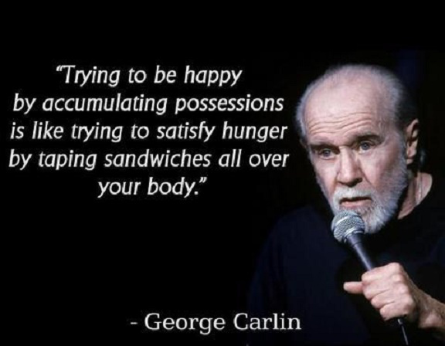
Parting with the Home-Things/Stuff
This Photo by Unknown Author is licensed under CC BY-NC-ND

Slide 18
The late, great comedian George Carlin had a whole routine on Stuff and Things and I believe he said “Things are things, but stuff is Personal!”
Let’s Talk about Things and Stuff for Just a moment
THINGS
STUFF
Take a piece of paper, on the top left side write the word Things and on the top right side write the word stuff. Take a few minutes and make these lists for yourself.

Slide 19
Now if I told you, you are moving into a smaller place and you could only take a smaller amount of your things and stuff how would you feel? OK now remove 2 items from each list . What to Choose? How do you feel?
What if you have almost 65 years of Things and Stuff?
This Photo by Unknown Author is licensed under CC BY-NC-ND
This Photo by Unknown Author is licensed under CC BY

Slide 20
OK, the children begin the MONU”MENTAL” Task of going through the Things and Stuff accumulated over about 65 years of time together.
Being a Daughter with the mind of an Activity Professional what kinds of STUFF did I save?, and of Course with the intention of decorating their room to have people enter and immediately already know some things about them.
This Photo by Unknown Author is licensed under CC BY-NC-ND

Slide 21
Things and Stuff that would bring a sense of comfort to them as they begin this new chapter of their lives. Things to help them navigate much more smoothly through the CHANGE.
1. Pictures (Of Course, of them as kids, their engagement party picture, etc.….
2. Dad’s Plaque for 15 years of volunteering for the P.A.L.
3. Picture of the Ship he was on in the Navy and his Honorable Discharge Paper
4. Dad’s father’s painting
5. Mom’s Yankee Banner
6. Rosary Beads next to her bed on night stand
7. Oddly I brought two things from their kitchen a can of soup that someone found for mom that had the name Caskey on it which is her maiden name and a rock that looks like a potato that they got it once in a bag of potatoes
8. Their bedroom furniture and living room end tables. Assorted other Stuff

Slide 22
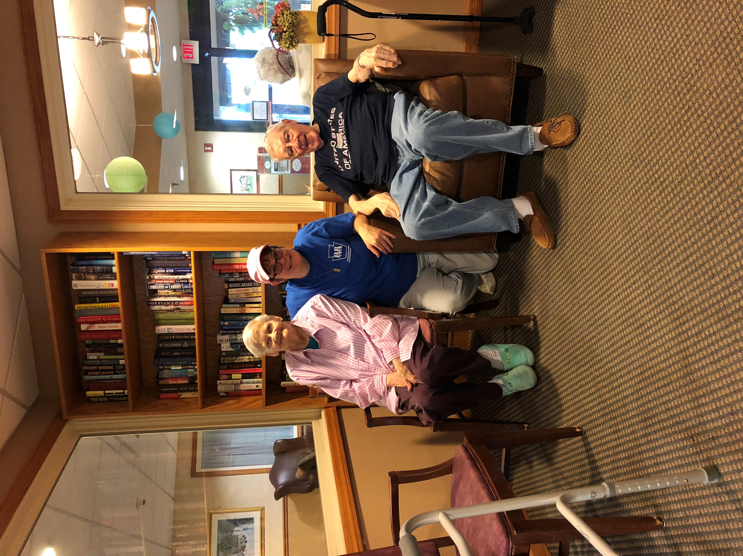
Remember Things are Things, but
STUFF is Personal!!!!

Slide 23
SIBILINGS- EMOTIONAL FALLOUT!!!!

Slide 24
Honestly, We as a family have done fairly well, but it can be a somewhat bumpy road navigating through the emotions that surface when faced with having to clean out and sell the home that you were raised in. You are navigating your own feelings, your parents feelings, your siblings feelings and it all can become a big jumbled mess! And if you are an only child, it all falls on you.
Can anyone share BRIEFLY if they have had either of these experiences what it was like?

Slide 25
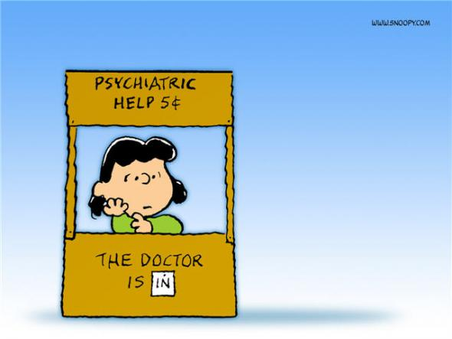
How does this relate to activities and other facility staff?
At sometime or another you may find yourself offering support or counsel to a resident or their family member. Any Thoughts? Experiences?
This Photo by Unknown Author is licensed under CC BY

Slide 26
Are we equipped to handle this task? I say YES!!!!
It is my belief that Activities Professionals are some of the most SELF ACTUALIZED people I have ever known.
Wikipedia (Not Webster's) defines Self Actualization as the motive to realize one’s full potential, Expressing one’s Creativity, Spiritual Enlightenment, In Pursuit of Knowledge, AND the Desire to give to and or Positively Transform Society.
Anyone come to Mind? Each one of our Facilities are
mini Societies

Slide 27
It makes great sense to me that the Activities Professional would be the most likely individual in the facilities team to help new residents and families adjust to the changes they are facing.
I would like you to listen to a little bit of a song about
CHANGE!!!

Slide 28
What did the Great Bard Bowie tell us in that song? Any Thoughts?
Much about this song has touched me with the experiences of the past 10 months since that fateful Friday before Christmas 2017
Phrases from the song like: “Turn and Face the Strange” “Time May Change Me but I can’t trace time” and especially “I watch the ripples change their size but never leave the stream of Warm Impermanence”

Slide 29
IMPERMANANCE = Not Permanent Now I have come Full Circle
This Photo by Unknown Author is licensed under CC BY
A Sure Fact Of Life! At almost 84 years of age my parents and their children navigated the rough seas of change.

Slide 30
And you and the dedicated teams of people at your facilities assisted us and many others before us with calming the rough waters of change. Let us continue our efforts to create environments that our elders can love much, laugh(and cry if need be) often, and live well. Let Us Assist Each Individual to figure out What’s Up? in their lives daily
This Photo by Unknown Author is licensed under CC BY-SA

Slide 31
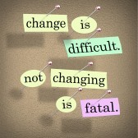
This Photo by Unknown Author is licensed under CC BY-SA

Slide 32
This Photo by Unknown Author is licensed under CC BY-SA-NC

Slide 33
This Photo by Unknown Author is licensed under CC BY-SA-NC

Slide 34
This Photo by Unknown Author is licensed under CC BY-NC-ND

