Slide 1
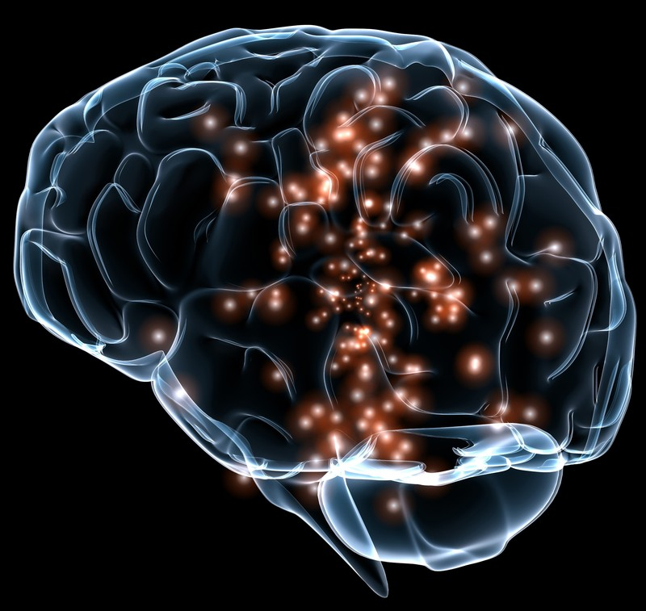
Memory Care – Challenges and Solutions
Gloria Hoffner – BA, ADC, AC-BC, CDP

Slide 2
First the facts – knowing our population
An estimated 6.7 million Americans age 65 and older are living with Alzheimer's in 2023. Seventy-three percent are age 75 or older.
About 1 in 9 people age 65 and older (10.7%) has Alzheimer’s.
Boomers were born between 1946–1964
– ages 77 to 59
Residents age 75 were age 20 in 1968.
In 1954 more women were a part of the
workforce than during the war.
Women’s rights movement begins in 1960.

Slide 3
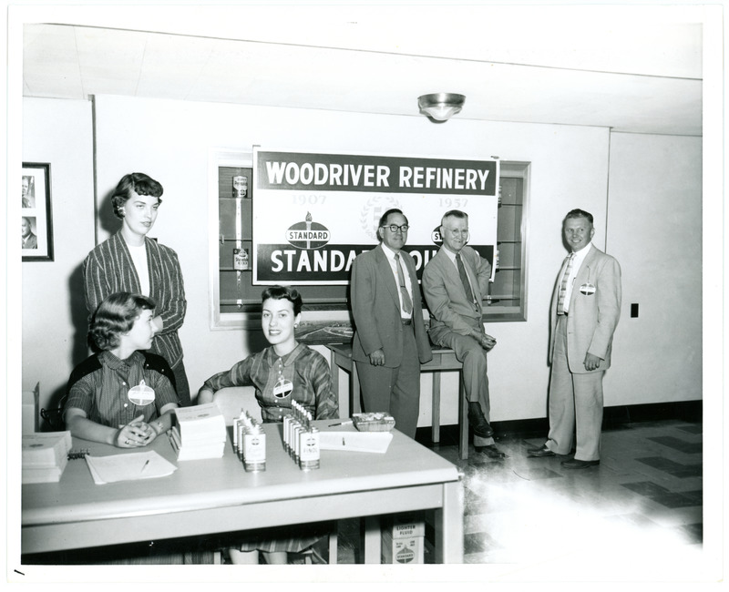
Our female residents had careers!
The majority of our residents were not WWII housewives! If they were 20 in 1945 they are 98 today. How many of your residents are over 98?
If your female residents were 20 in 1964 they were first women to get their own credit cards, saw formation of the National Organization of Women in 1966, and passage of equal pay legislation in 1963.
The number of women workers, continuing a long-term upward trend, rose from 16/2 million in 1950 to almost 22 million in 1960—a gain of 35 percent. This greatly exceeded the 14 per cent increase in the number of women of working age in the population—57 million in 1950 compared to 65 million in 1960.
The Baby Boomers are here – and they need memory care that adjusts for their lives and memories not their parents lives. Baby boomers include Bill Gates, Cher, Diane Keaton, Steve Jobs not Frank Sinatra and Dean Martin.

Slide 4
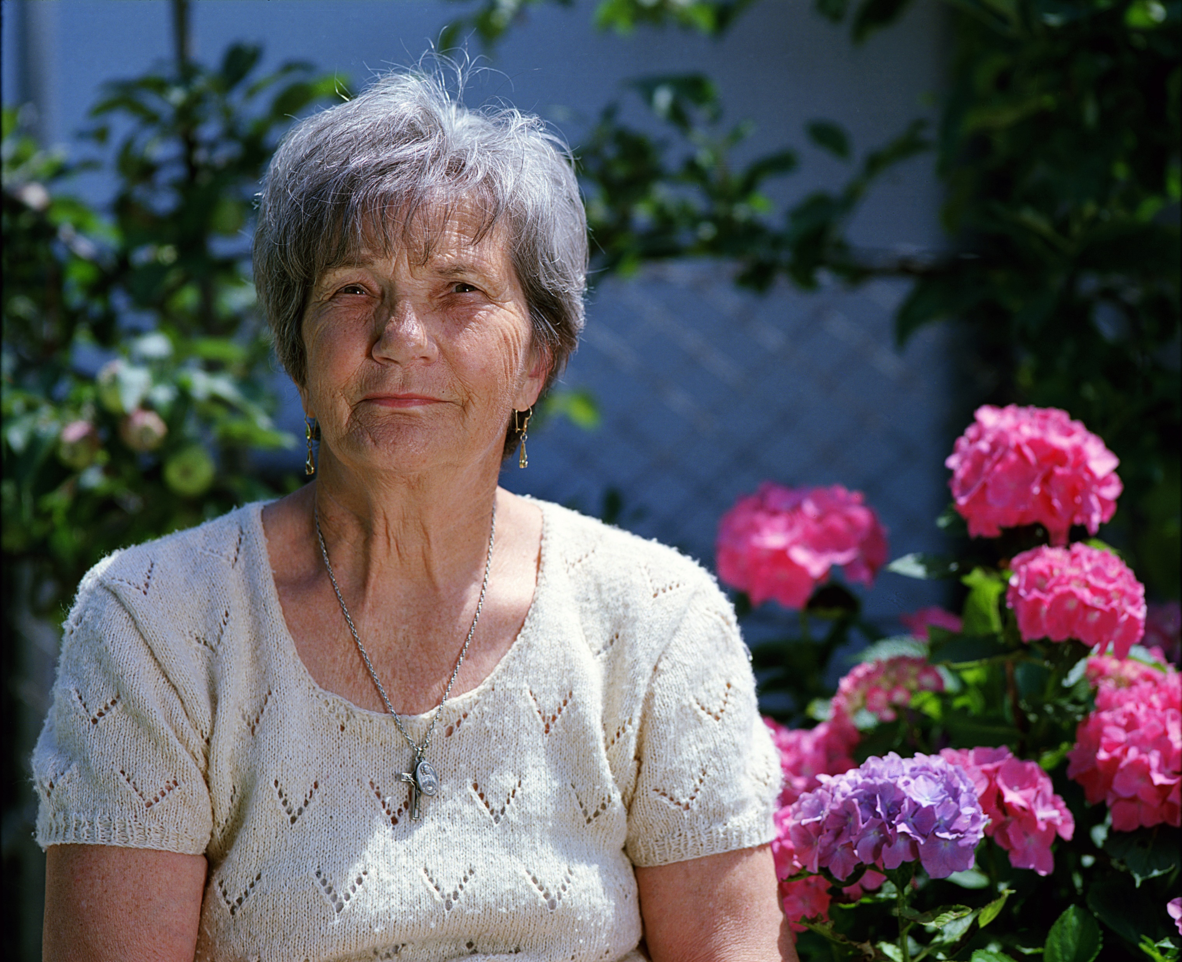
Audrey’s story
Audrey is a new resident in memory care. She is 77 years old.
Audrey is single; never married; no children; one nephew as family.
Audrey has a masters in music education. She taught music, conducted school bands and choirs as well as church organist for over 45 years. And she conducted a community band for over 23 years.
Hobbies – astronomy – she had her own telescope. Walked one mile every day. Took up oil painting in retirement. Traveled to all 50 states. Active in church services and charity work.
What will you offer her as an activity professional? She never gambled, never did crafts, doesn’t drink alcohol. Suggestions?

Slide 5
Everyone at every stage needs purpose!
Towel folding – giving residents a way to help
Great goal but try another solution. Instead of folding baby clothes or wash cloths, have residents button, hang and fold adult sized items and clothing. A study from Australia found residents lose skills when they move from home into a care facility where ADLs are done for them. When residents practiced ADL skills with adult sized clothing their skills improved.
Eating skills – residents practice spooning pasta, pouring water and improve life skills reducing the need for eating assistance.

Slide 6
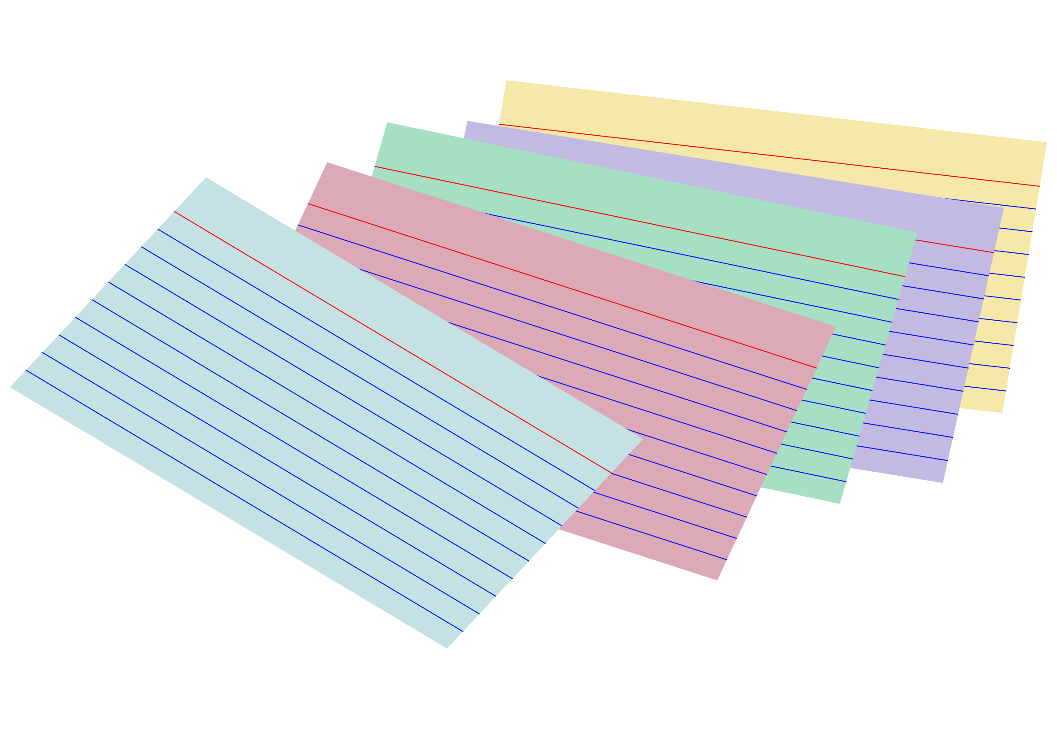
Giving restless residents appropriate tasks
Do a survey of your residents careers and hobbies.
Make a spread sheet – who worked in business, who was a farmer etc.
Base your activities on these interests not on ideas for generalized population.
Steve Moran columnist for Senior Forum – “Why is it only our residents we group for activities by age? We don’t expect every 20 year old to love surfing or every 50 year old to be a pickle ball fanatic. Why is it only care community residents we expect to ‘all’ love bingo, crafting, trivia? In their own homes they didn’t spend every minute lock step with their neighbors from 2 to 3 p.m. every Tuesday.”

Slide 7
Daily Routine – Movement
Exercise is great in the morning – but what about movement during the day?
Homelike – do your residents stay in the same space all day long? Eat breakfast, then do exercise, then crafts then lunch then bingo then dinner…. Hmmm in their own homes did they spend all day in the kitchen?
Rooms have meaning. Residents eat in one are then get up and go into another area for exercise. When eating area is only for eating it sends clues to the brain which are proven to improve residents interest in food. Tips – same music, no tv, staff talk to residents not each other, feeding hand over hand method

Slide 8
Daily tasks – do what you love…
Language matters - “John ‘used to be’ an accountant”. Only care communities say ‘used to be’ when the real world term is ‘retired’.
Retirement does not mean no longer interested. How many of your residents who worked in construction love to give maintenance staff tips? Do you have residents who wander picking up items as they go?
“I’m Still Here” John Zeisel – should be mandatory reading. They don’t wander to roam. They are trying to orient their brains to where they live, to understand their space.
Residents actions are physical ways to interact with their world.

Slide 9
Understanding communication
The Penn FTD research found residents with dementia lose the ability to speak for several reasons:
Spontaneous real-life speech is imperfect in many ways. It contains disfluencies and ill-formed utterances and has a highly variable rate. When listening to spontaneous speech, the brain needs to contend with these features in order to extract the speaker’s meaning. Here, we studied how the neural response is affected by four specific factors:
1) Speed
2) Grammar
3) Word identification
4) Hearing

Slide 10
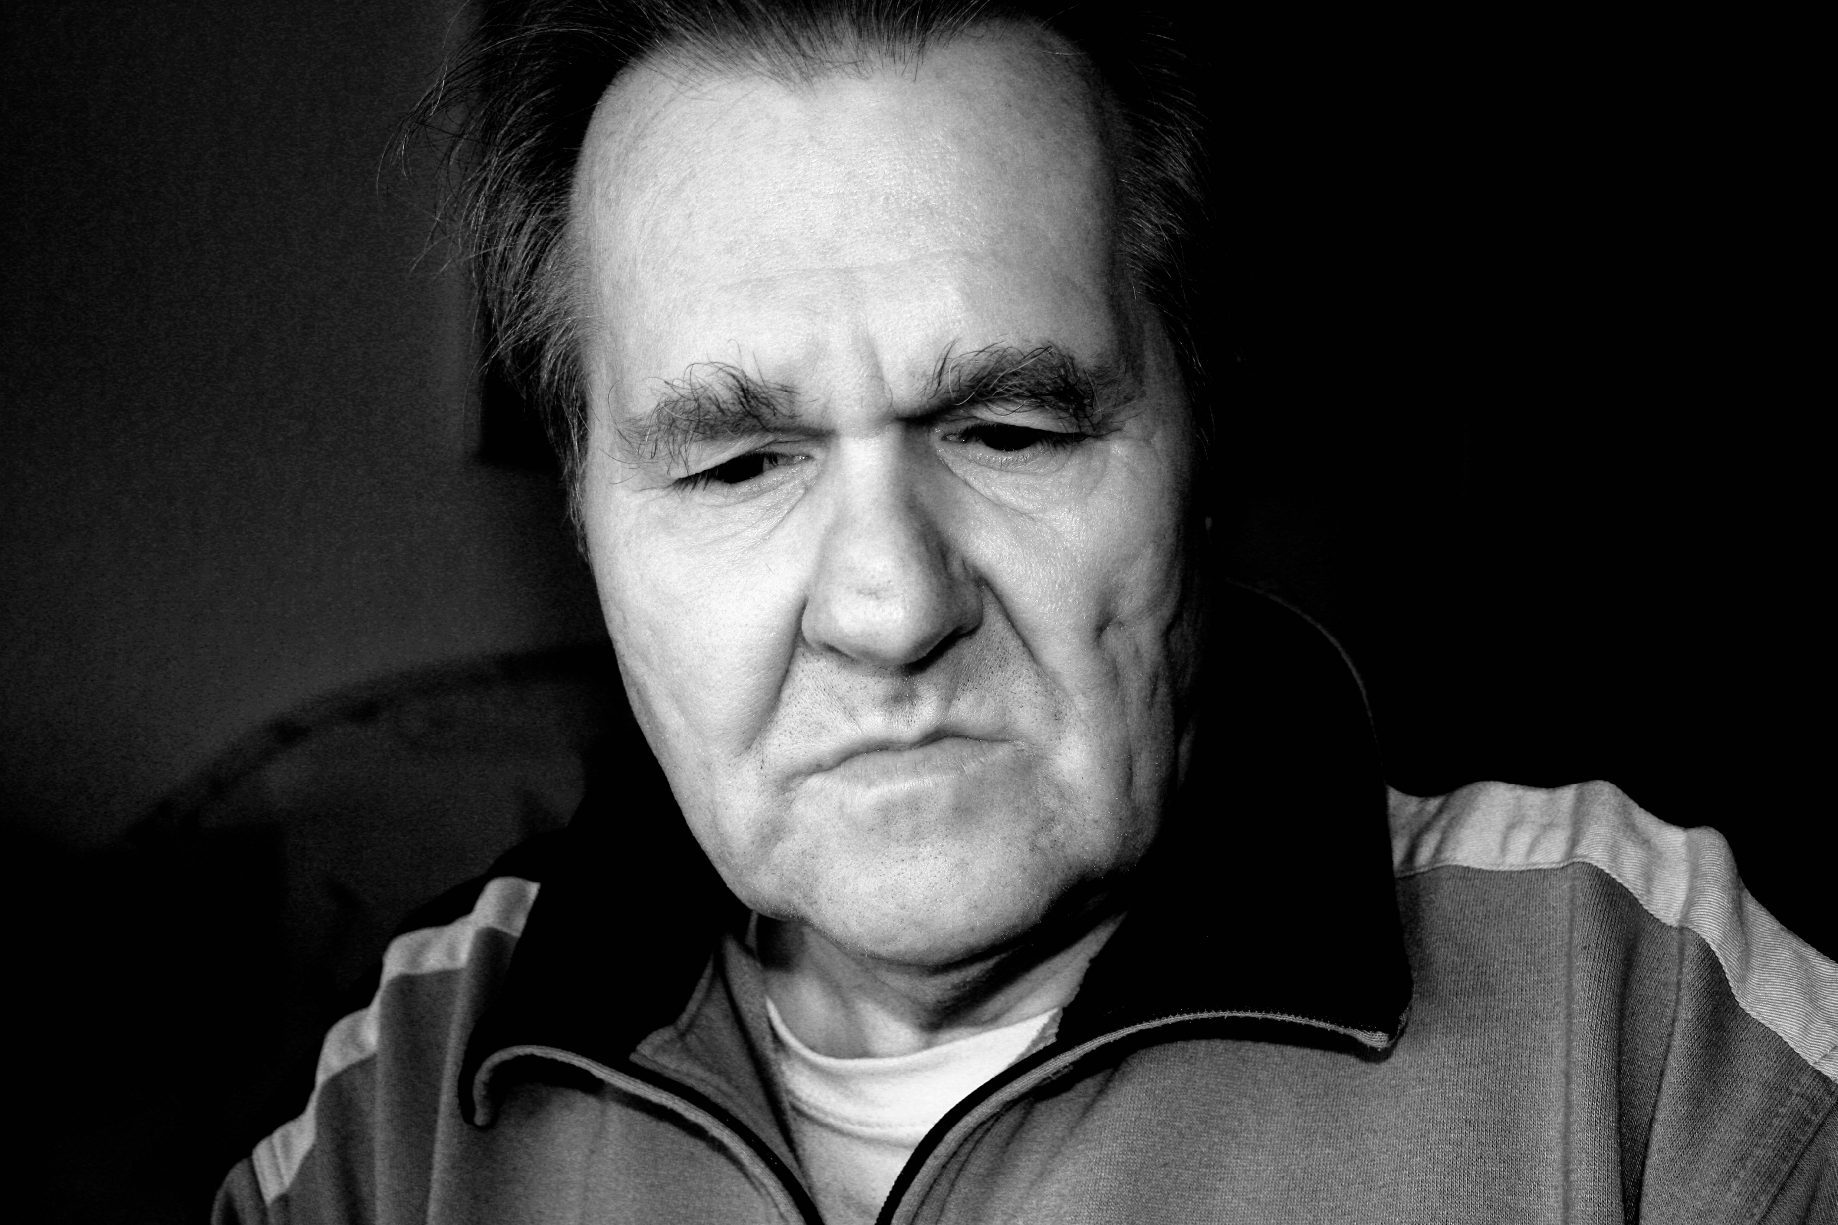
Behavior IS Communication
Consider this – you HATE ketchup but you do not have the ability to speak and every time you get your hamburger (which you love) it has ketchup all over it! What would you do?
Picture chart – let’s try it! Works for non-verbal customers at McDonalds so why not in our communities?
When we have a resident whose behavior is causing troubles.
John keeps grabbing things off the lunch table and stuffing them in his pockets. Susan bangs her coffee cup. Joe keeps getting up from the table. Why?

Slide 11
Communication Board

Slide 12
Why is John, Mary, Susan, Joan doing that?
John is constantly trying to take apart his wheelchair. He’s not interested in puzzles, laundry, bingo, trivia… frustrated staff push his wheelchair between a table and the wall to block the wheelchair bolts. What happens next?
Mary is a nice lady, friendly, but she is going into every residents’ rooms and taking all the calendars down. She won’t join a group activity. Why is she obsessed with calendars?
Susan is up all night and sleeps all day. Staff tries to help by keeping her active during the day, but as soon as she sits she sleeps then wanders at night frustrating limited night staff. Can anything help?
Joan is anxious. She is nonverbal but clearly upset. She rummages through drawers and then breaks down in tears. Why?

Slide 13
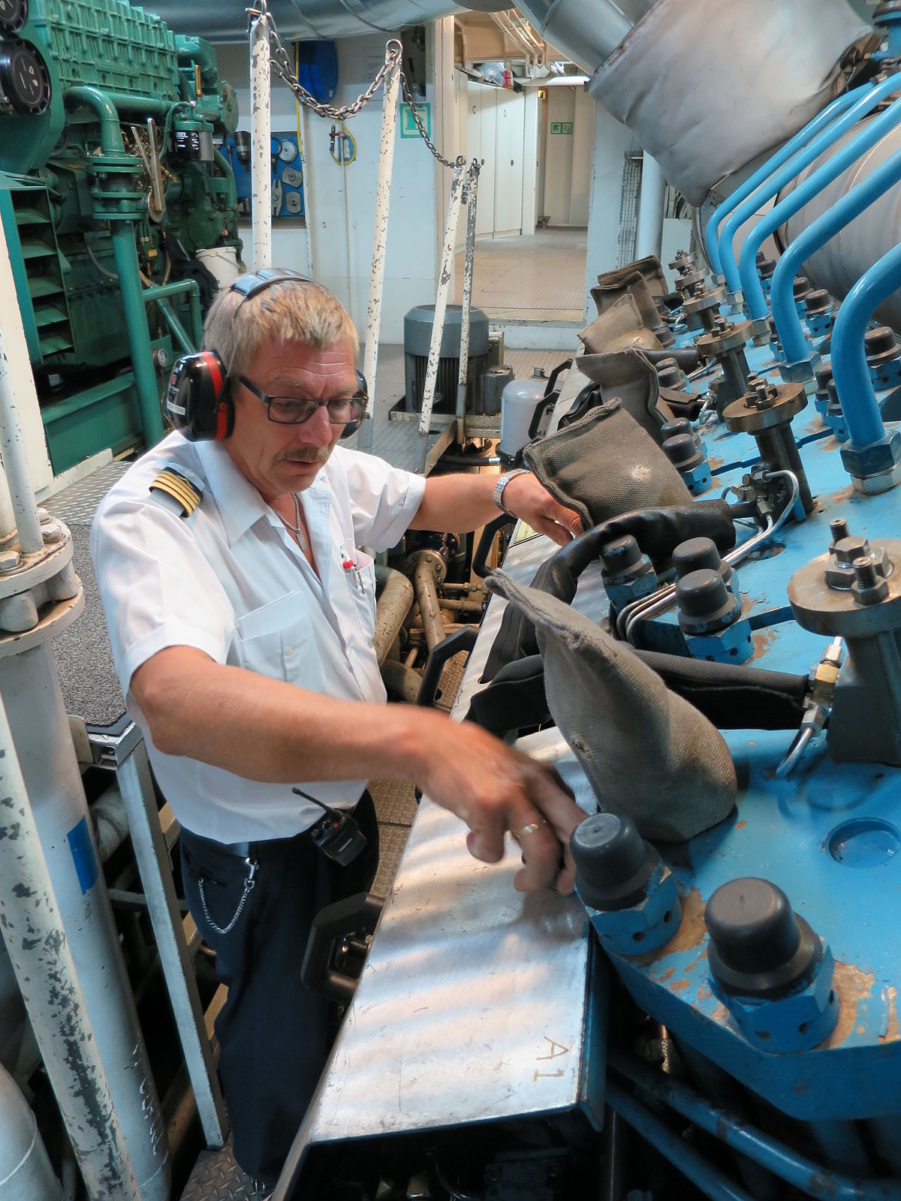
John
John was an engineer. He invented digital tv. He was a type A personality who in addition to his job ran a youth group at church teaching how to build birdhouse, install shelves etc.
His personality his whole life was being busy and being useful. He sees something and wants to help by doing. Cause – Institutional memory.
Solution – real large sized pipes, nuts, bolts – large but useful. Busy boxes don’t work because residents who may not remember their address still know real from plastic toys. They used real tools for over 40 years. John puts them together during the day. Night staff untwist as he sleeps.

Slide 14
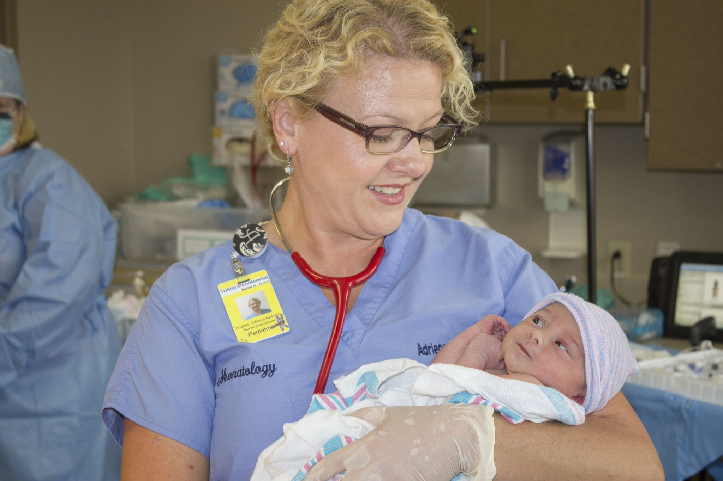
Susan
Why won’t Susan sleep at night? Susan spent 30 years working weekend night shift as a nurse. This way she was home with her children during the week and her husband was with the children on weekend days when Susan slept.
She is living in a memory care setting! She may not be able to say where she is, but she sees the nurses giving meds, she sees ‘patients’ so her brain says, “I must be at work.”
Solution – let Susan sleep during the day whenever she wants and her body needs sleep! At night give her a clipboard with text and a chair at the nurses station. She can write on the chart and feel useful.

Slide 15
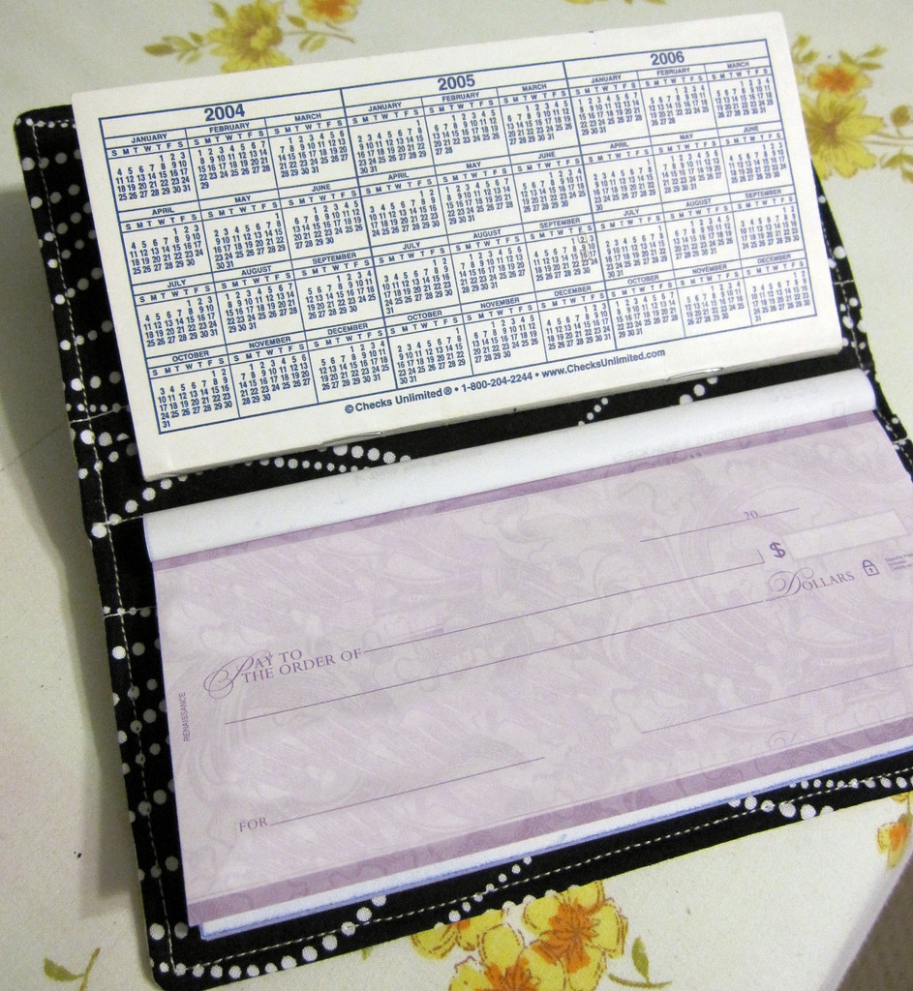
Joan
Why is Joan rummaging drawers?
Joan was a homemaker but she will NOT sit and fold towels,
or roll silverware. Instead that activity makes her angry.
Speaking with her family we learn that Joan was the money manager in the family. She paid the bills, did the taxes, kept track of the check book. So the rummaging – she is desperate to find her Social Security check.
Her anxiety is the loss of that check is disastrous for the household and she feels responsible!
Solution – give her a purse with a fake check in a business envelope. Give her a fake checkbook and a ledger for her room.
You won’t need this for gen x - From 2000 to 2015, the number of checks written by consumers declined from 19.3 billion to 7.1 billion, a drop of 63 percent. Over the last decade, the Survey of Consumer Payment Choice also has reported a decline in the number and percentage shares of consumer payments using paper checks.

Slide 16
Martha
Martha keeps going into other residents rooms and removing items. Why?
There are 9.8 million retail workers in the USA and Martha spent 30 years as one of them! She worked at Macys keeping displays neat. She is not stealing from other residents, her brain is making her collect items for a display.
Buy an assortment of flea market items – purses, trinkets, jewelry and place on a baker’s shelf next to a stack of canvas bags. Let Martha and anyone else “shop” these items and at night staff return the items to the rack.

Slide 17
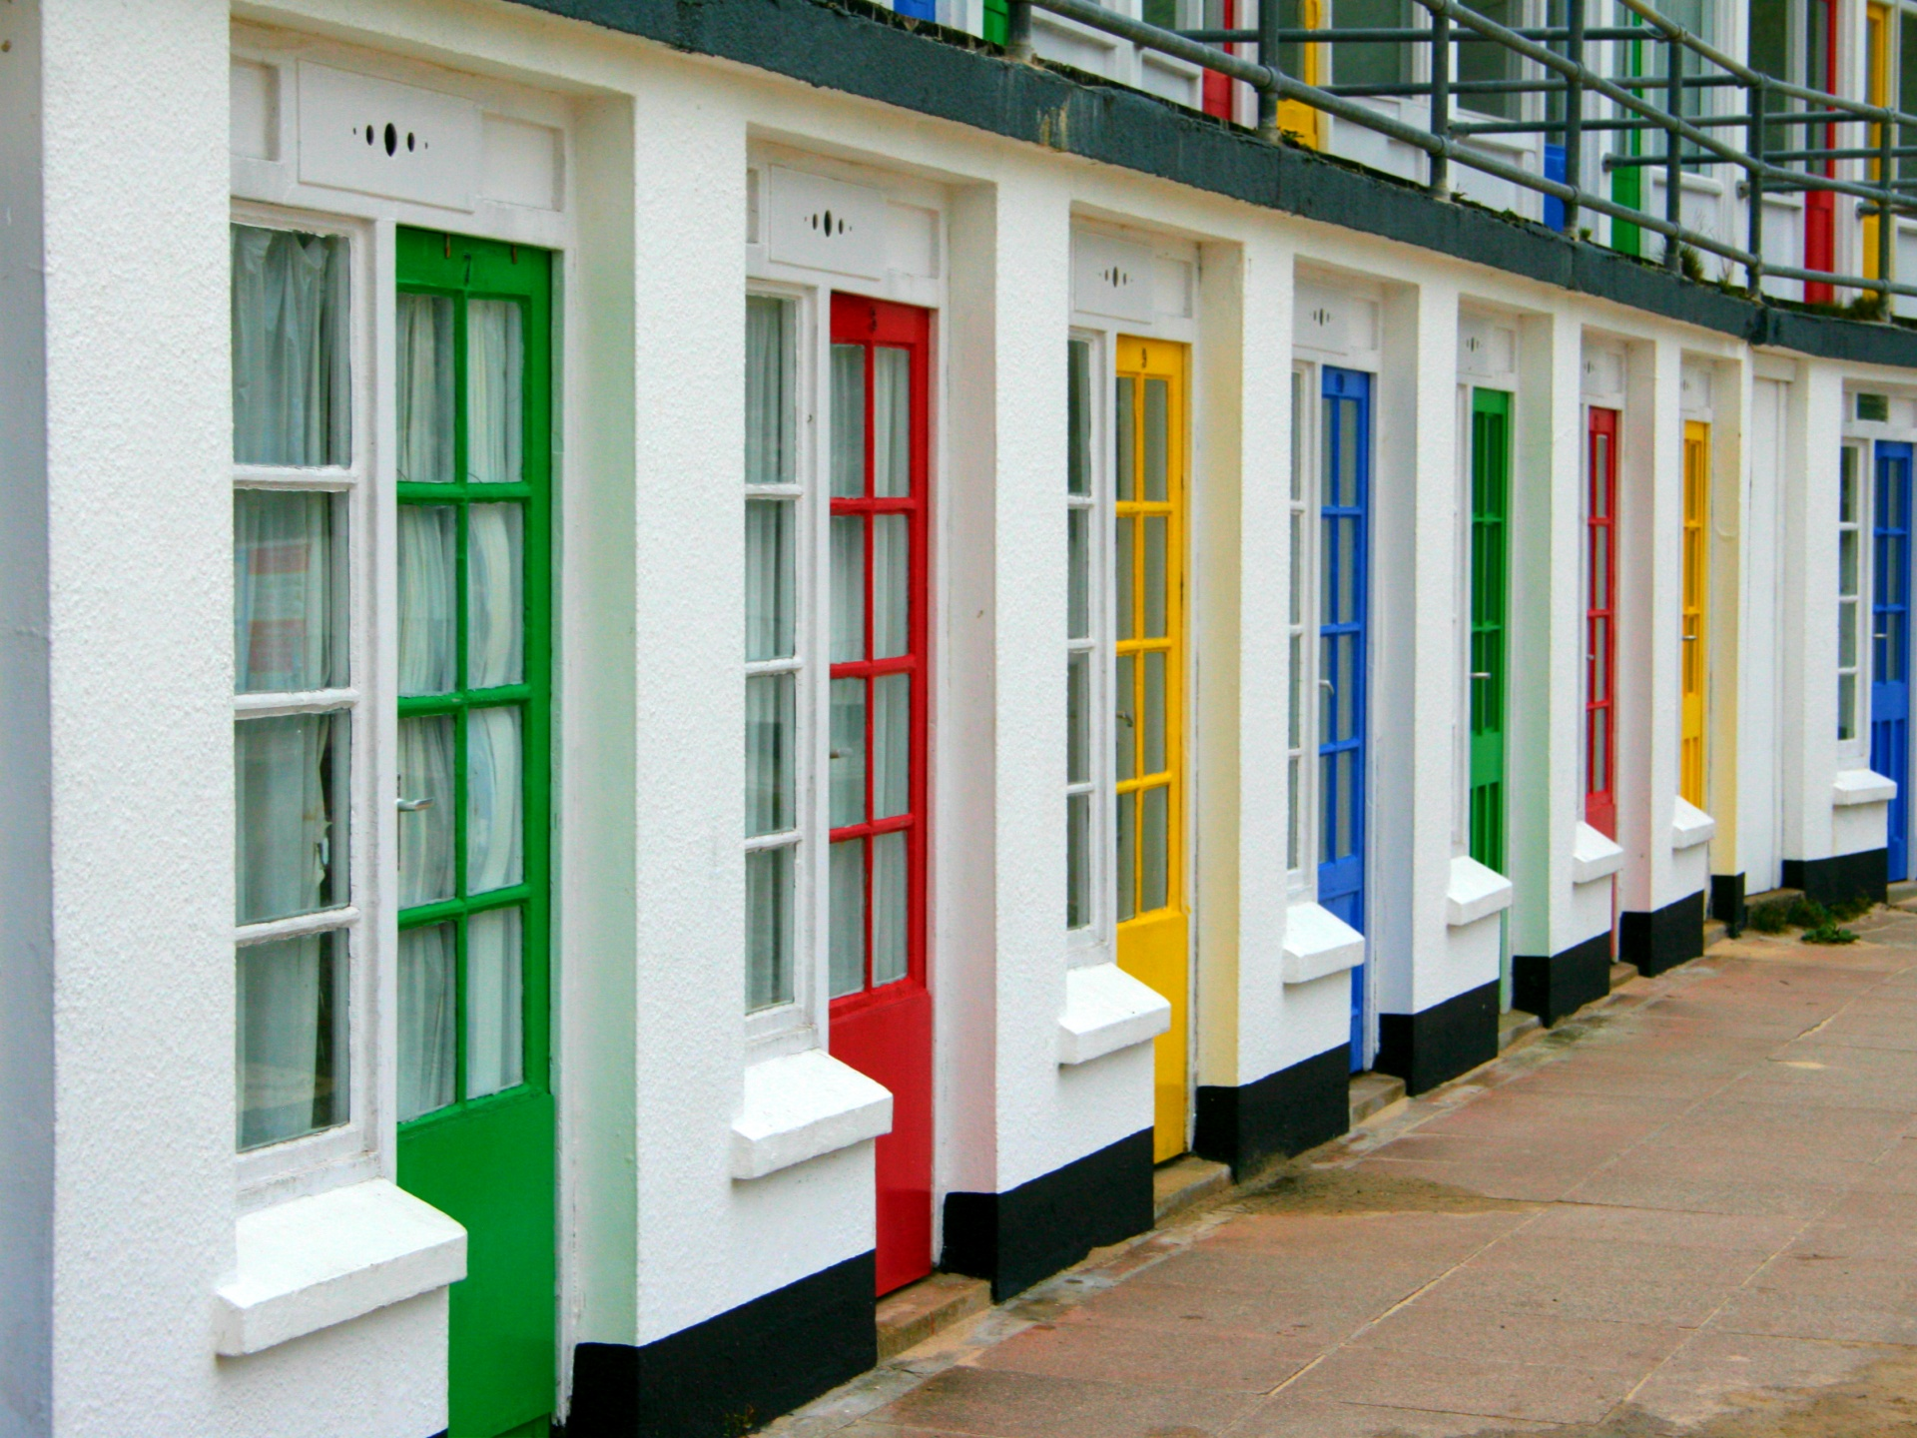
Doris
Doris is a new resident who won’t sit still. She says she wants to play bingo but within minutes of joining the group Doris is standing up and leaving. She starts wandering halls and opening doors. Why?
Orientation – when humans are in a new situation their brains make a mental note of locations. That continues even with memory loss.
Make 5 inch large printed names of each resident taped to their bedroom door. Has to be easy to read – shadow boxes don’t work!
Make Doris a 6 inch by 6 inch laminated reminder card – Name, where I live, room number – large block letters. She keeps with her all day so if during music her brain says “where am I” she holds the answer.

Slide 18
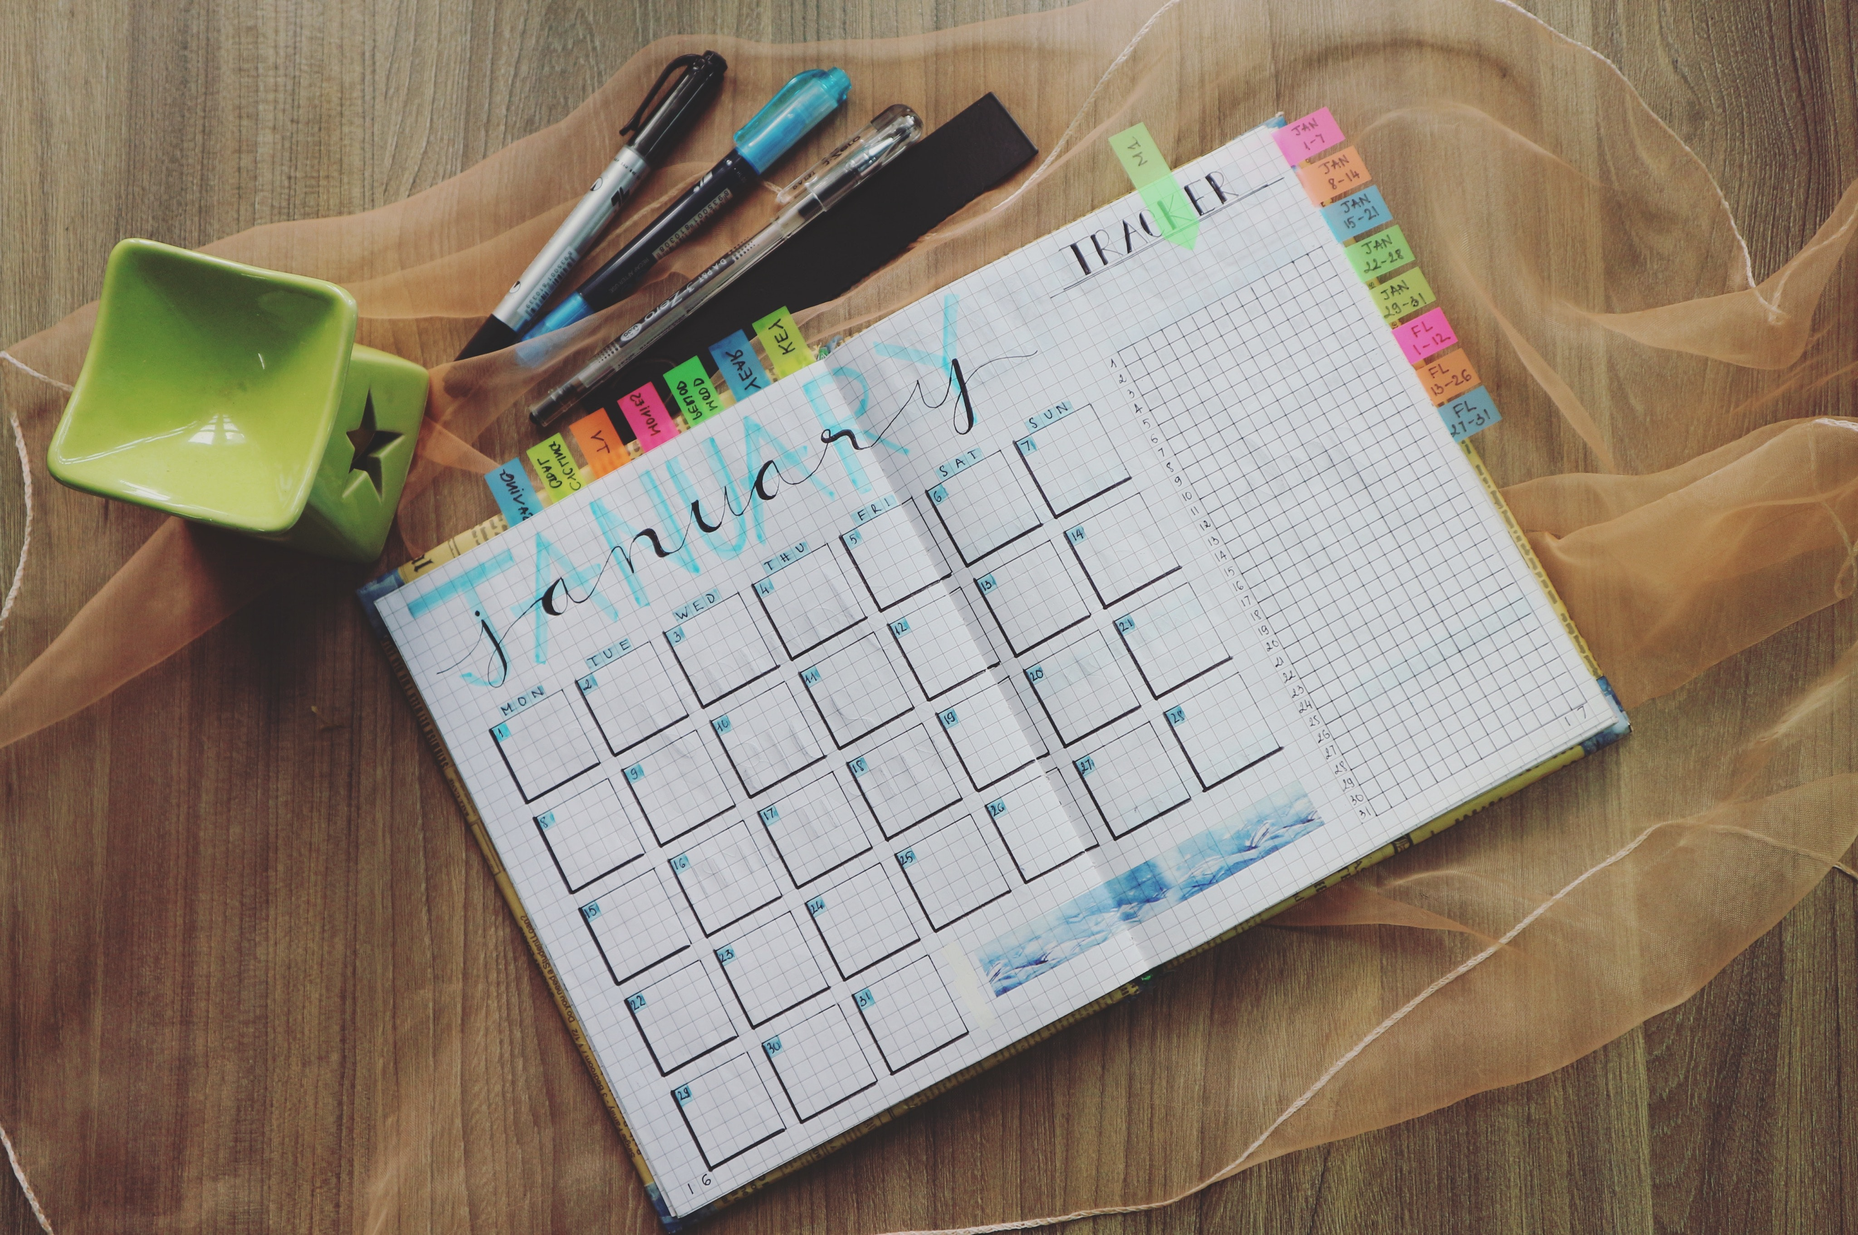
Mary
Mary was a school district superintendent. She was highly organized, great at multitasking, always planned her day. Her family moved her to memory care because she mentally was unable to care for her needs, but that didn’t change her core. She organized her dolls!
She is collecting calendars to create a planner and a file system. She can’t explain it to the staff, but she is physically missing the day planner she always kept with her.
Solution – Buy a Dollar Store planner Mary can carry with her at all times. Give her color coded cards to sort in an index box. Her comfort item. Comfort items are more than stuffed animals and dolls. Think of what you have with you every day – and how you feel when you misplace those items?

Slide 19
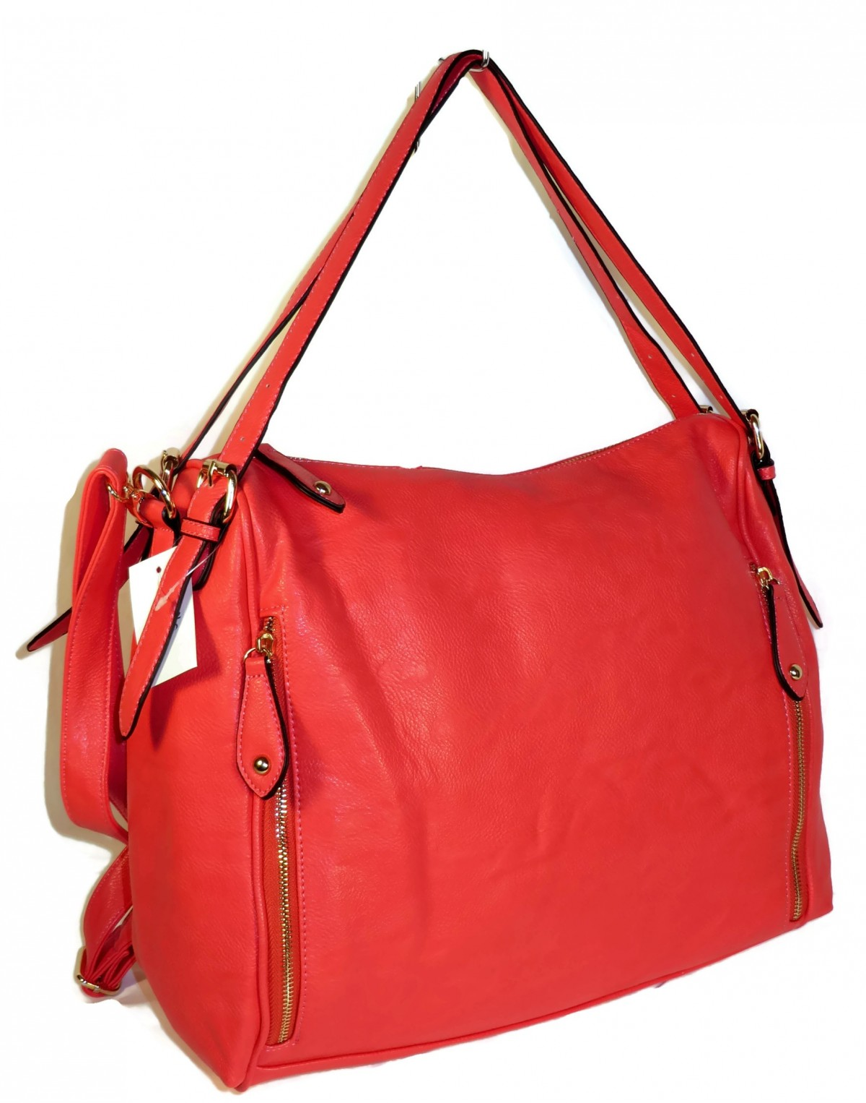
Group Comfort Items
Dr. Donald Winnicott coined the term in 1951 to refer to any object, usually a soft plush toy, which a person regards as particularly special to them. Winnicott identified that having ‘transition’ or comfort objects through our adulthood, with not just soft toys but also photos, souvenirs and other items which we warmly associate with happy times, places and relationships.
Handbag Circle Activity – Collect handbags from garage sales etc. Fill them with keys, tissues, a change purse, lipstick etc. Seat residents in a circle and let them pass around the bags and reminisce about trips, shopping, church etc.

Slide 20
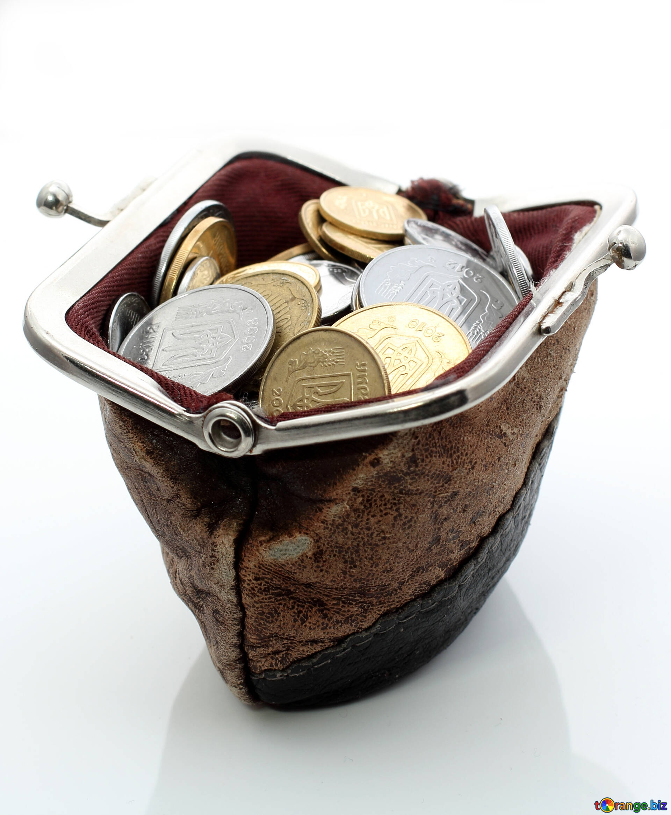
Comfort item research
Dr. Anna Madill of the University of Leeds and Jenny Arthern, psychological therapist at Wakefield and Pontefract Community Health, studied the benefits of “transitional objects”. A transitional object could be anything that was used in lieu of a human relationship.
“Comfort items tap into the inner child, a way of seeking strength in yourself,” Arthern said.
“It isn’t immature, it’s sensible. The ability to derive comfort from an inanimate object dates from an early developmental stage.
“Little children learn that an object still exists even when they can’t see it. So they don’t feel abandoned when their parents aren’t in the room. It’s about self-reliance. We’re alone but we imagine we’re not.”
Cell phones – do you go anywhere without one? There are roughly 6.92 billion smartphone users across the world. That’s 86.29% of the global population, as of 2023. 59.16% of website traffic comes from mobile devices, as of 2022. (Zappa.com)

Slide 21
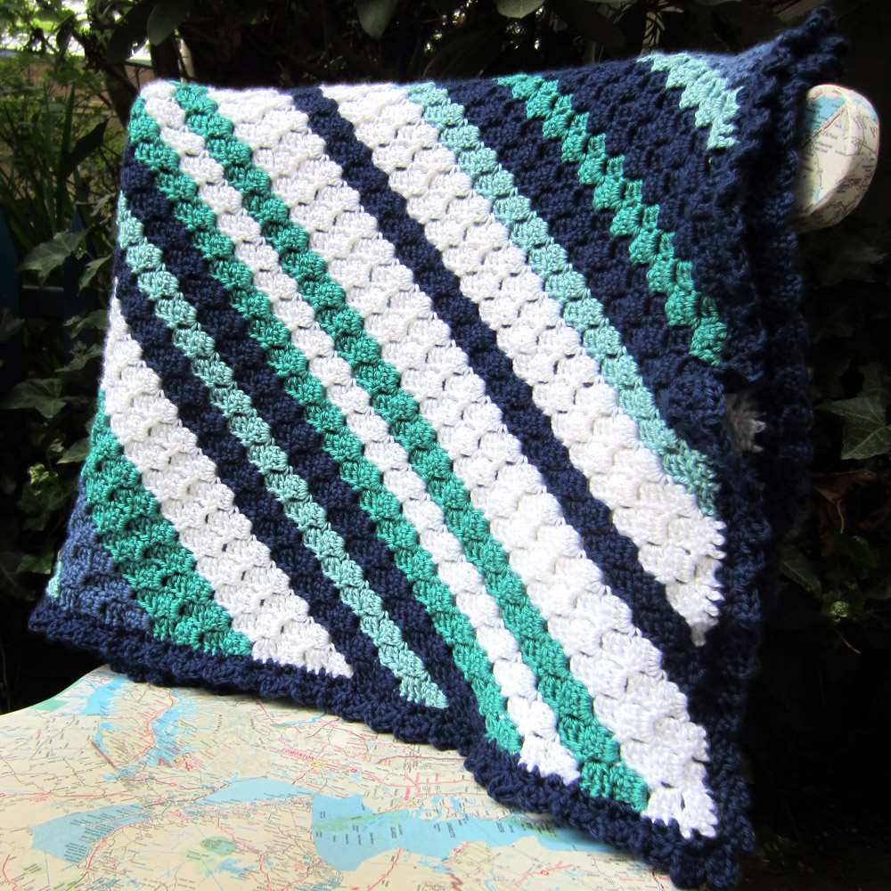
Benefits of comfort items
They can provide a springboard for conversation, including in therapy
Staff can use them proactively, e.g. including the comfort object when a resident is very distressed or disoriented
They can help prepare the patient for sleep (eg as part of a getting to sleep ritual)
They can help staff and carers orientate within the person’s framework of who they now are
They’re soothing, reassuring, supportive, uplifting, consoling, reliable, constant, permanent (unless lost…)

Slide 22
Comfort items more than dolls
Emotional memories
Something specific about the item
When it was given to them
Who gave it
What traumas and joys it’s seen the owner through
What it reminds them of ex. a soft toy dog or cat which brings happy thoughts of patient’s pet.
It might be a change purse they always carried in their pocket or house keys or a silver dollar.

Slide 23
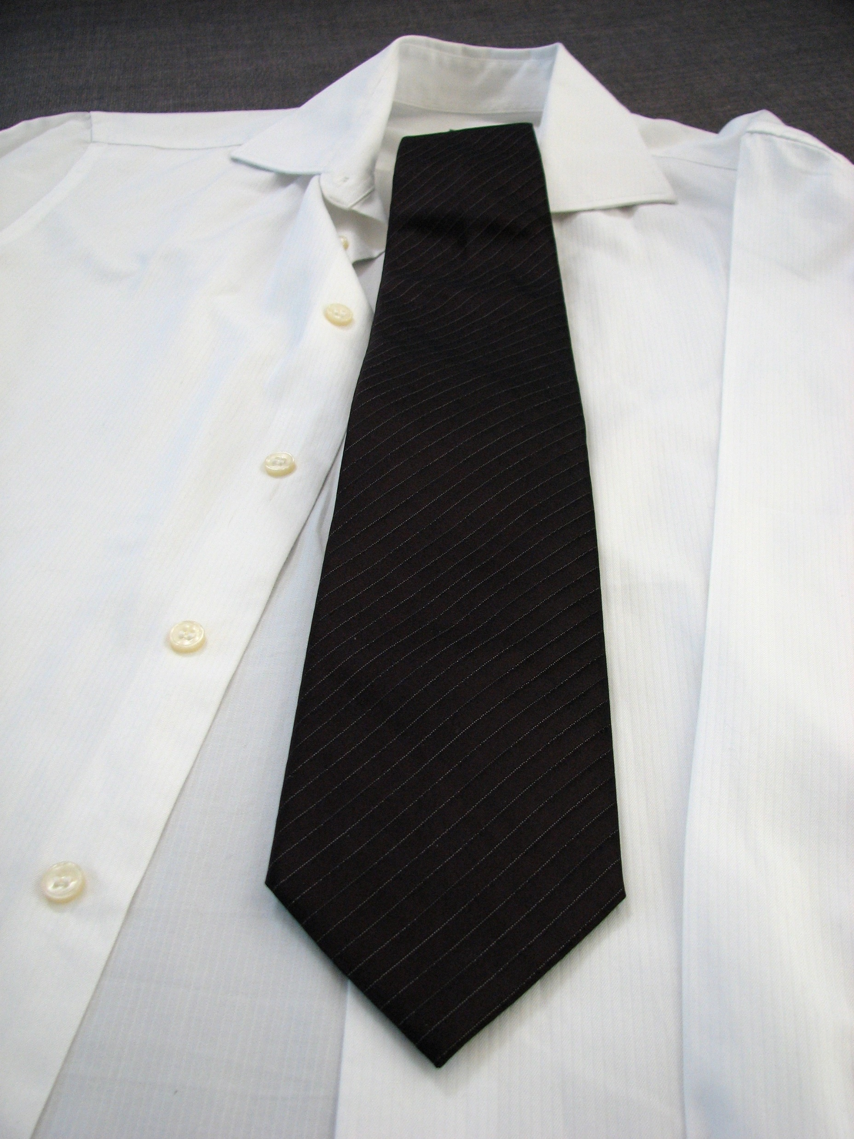
Tom
Tom will not get dressed in the morning. When coaxed out of bed, into a shower and then into his Eagles sweatsuit he will then refuse to leave his room. Why?
Tom was a banker. Every day for 30 plus years what did he wear to work? How did he dress in public for church, social events etc.
Tom may no longer hold a job on paper, but in his mind he holds a job that has public respect. He is an elder in his church. He knows his ‘proper attire’ in public. And he knows how he feels in pajamas.
Solution – Allow Tom to wear a dress shirt and tie when in he leaves his room.
Gen X - In the 90s, the Gen-X grunge movement extinguished the glamour and greed of the 80s; once a subculture, their "anti-fashion" look of flannel shirts, Doc Martens, military jackets and oversized sweaters gained more mainstream approval. (BBC Culture October 2022)
John Fetterman – Senator who challenged Congressional dress September 2023.

Slide 24
Josie
Josie loves music. She belonged to her church choir since she was a little girl. She loves to sing – but sometimes her constant singing disrupts group events.
Solution – lollipops. She can’t sing while eating a treat.

Slide 25
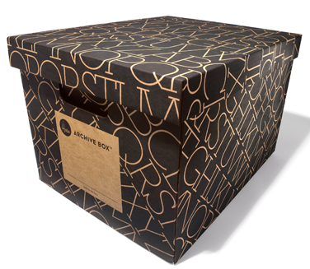
Where is my STUFF ?
A resident moved in, family set-up her room, she is pleasant for a few days and then starts demanding over and over – I want to go home!
Therapeutic fibbing – Her son tells her she is staying here until the burst pipes in her home are repaired.
She calms down, but the next day insists on having her son bring her family thanksgiving platter. Where is it?
Solution – Before the resident moves in and before families closing up the resident’s house for sale etc. families should be told to get two large containers. Fill both with household items the resident knows well – that living room painting, the needlepoint pillow etc. Then when the resident asks “where is my stuff” bring items, rotate them each visit to assure residents.

Slide 26
Missing clothing
Maria is very angry with Betty. “Betty is wearing my sweater, MY black sweater and I want it back!” Maria grabs Betty and Betty slaps Maria.
Clothing goes missing despite labels etc.
but why does it so upset the resident?
You promise to replace it. It’s just A SWEATER!

Slide 27
Memory Care and Human Sexuality
Intimate contact. What do you do when two residents get “too close for comfort” for staff and family?
Can a husband not in your community have intimate relations with his wife who is a dementia unit resident?
What if two residents, married to someone outside the community, want to be intimate? Legal document.

Slide 28
A Legal Case Involving Consent for Sexual Activity and Dementia
In 2015, a couple made news due to this very question of capacity to consent to sexual activity. The couple—Henry and Donna Rayhons—lived in Iowa and were married in 2007 after meeting later in life. Several years later, Donna developed Alzheimer's disease.
Fast forward to May 2014, when Henry Rayhons, age 78, was accused of sexually abusing his wife in the nursing home where she resided due to her dementia.
Rayhons contended that he did not have intercourse with his wife on that particular night but stated that they had kissed and touched each other. He also reported that she initiated sexual interaction from time to time. The nursing home where his wife resided, however, felt that she could not consent to sexual activity and reported the issue to the police after hearing that sexual activity had occurred between the two.
Eventually, the case went to court and, after testimonies and deliberation, the jury found Rayhons not guilty. However, the case stirred up many questions regarding sexual activity among people living with dementia, including the issue of how to determine the capacity to consent and who should make that determination.

Slide 29
Relationships between residents and marriage
In the Alabama Law Review, Alexander A. Boni-Saenz suggested the idea of allowing people to draw up a document that outlines their choices for sexual activity in the event that they become mentally incapacitated. For example, someone could state that they want to continue to engage in sexual activity with their spouse upon their mental incapacity. The central thought of those who support this idea involves preserving the right to engage in mutually beneficial sexual activities, usually within a committed relationship, and preventing the possibility of criminal prosecution due to mental incapacity.

Slide 30
Is it love or exploitation?
One surveyor may conclude that the facility failed to protect the resident from sexual exploitation based on the lack of proof that the resident can consent, thus concluding the resident was sexually abused. Another surveyor may conclude that the facility failed to protect the resident's right to choose and to enjoy the quality of life through maintaining a meaningful, intimate relationship if a relationship had been pursued but not allowed. Facilities are often placed in a guessing game of how the surveyors might interpret a situation.
Solution is clear policies discussed with all residents and family members. (By Esther Heerema, MSW
May 20, 2023 – Verywell website)

Slide 31
Too little staff to residents ratio
Problem – one activity person and 27 memory care residents.
Group solutions – Kick the Kitty; Fruit Loops game; Coffee hour
Activity person becomes a floater. Set up tables for each resident based on their interests.

Slide 32
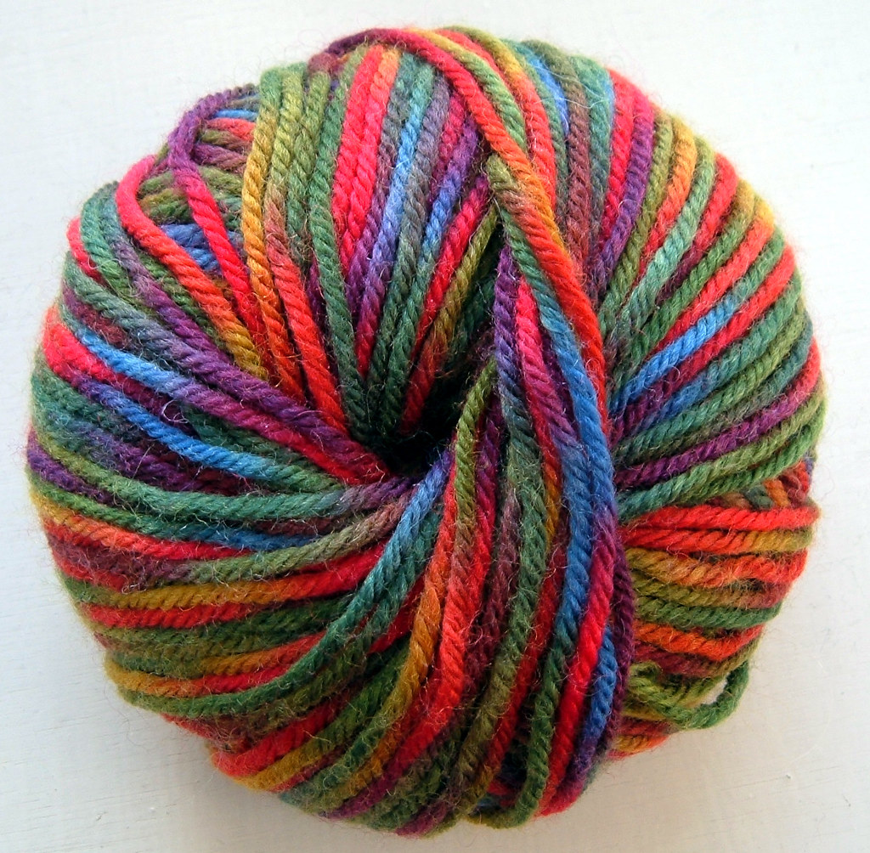
One staff, lots of residents.... What to do????
Create personalized activities within one room.
Mary crocheted all her adult life – give her yarn to unravel.
Susan was a baker – measuring spoons, cups, dry pasta
Joe accountant – ledger and fake checks
Martha – puzzles
Nancy – magazine photos to arrange for scrapbooking
Each resident arrives in the room after breakfast for their specific tasks and pleasure. Play music, serve coffee, this is their morning routine. After lunch, group events by day – Monday music, Tuesday art

Slide 33
Night owls
Every resident didn’t work 9 to 5.
Due to our modern 24-hour society, nearly 15 million people in the United States work full-time night shifts, evening shifts, rotational shifts, or other such irregular schedules.
Some residents were early morning farmer, others overnight copy editors so why is everyone awake, active and sleeping at the same time in our communities?
An assisted living set up art room, pool and game room, movie room their residents at midnight or 3 a.m. are free to use these rooms.

Slide 34
Promises made during family tour
Resident was a farmer. Family was promised by marketing that the resident would have time outside every day. You don’t have the staff to take her outside and stay with her one-on-one so now at care conference the family is complaining, and even called the Ombudsman.
1) Work with nursing for CNAs to share in the rotation of bringing residents outdoors. Ironically places that allow residents to smoke means residents who smoke have regular outdoor time while non-smokers don’t have the same opportunities.
2) Do regular activities outside – coffee hour, current events, book club etc.

Slide 35
Getting staff to help transport
All staff required to bring one resident to group activity. The activity staff set up the room and announce by loudspeaker the activity will begin. Nurses, CNAs, housekeeping, office – each bring one resident. When the activity concludes – announcement and all staff assist resident to their rooms.
Benefits – time! When activity gather and transport residents end up sitting before and after the event. Many won’t come because they don’t want this long sitting period. Faster transport, more attend, frees up caregivers as residents are engaged.

Slide 36
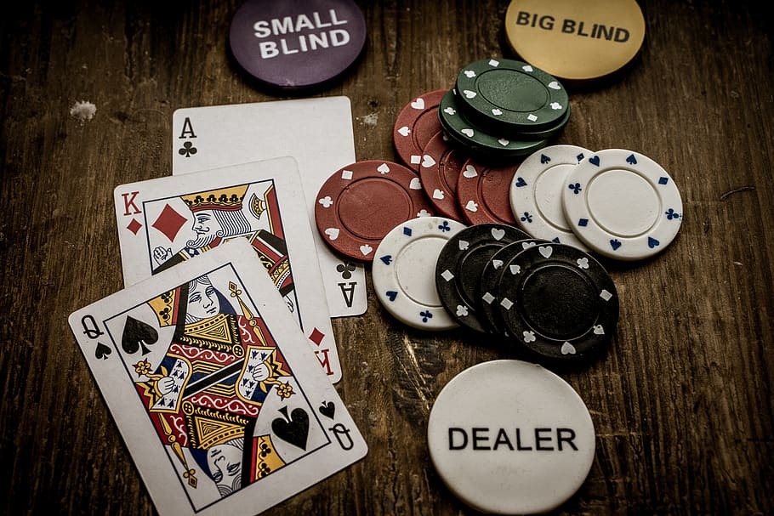
Getting staff/community volunteers to assist in activities
Survey – what are the hobbies, the national origins, the interests of the staff – ask who will donate one hour a month?
Poker – social worker ran a resident game.
Food – dietary manager did a cooking demo.
Housekeeper – book club – or watch a tv series and discuss.
Bible study – one on one visits to read to residents
Ask local veterans to visit your veterans once a month. These one on ones create much needed friendships.

Slide 37
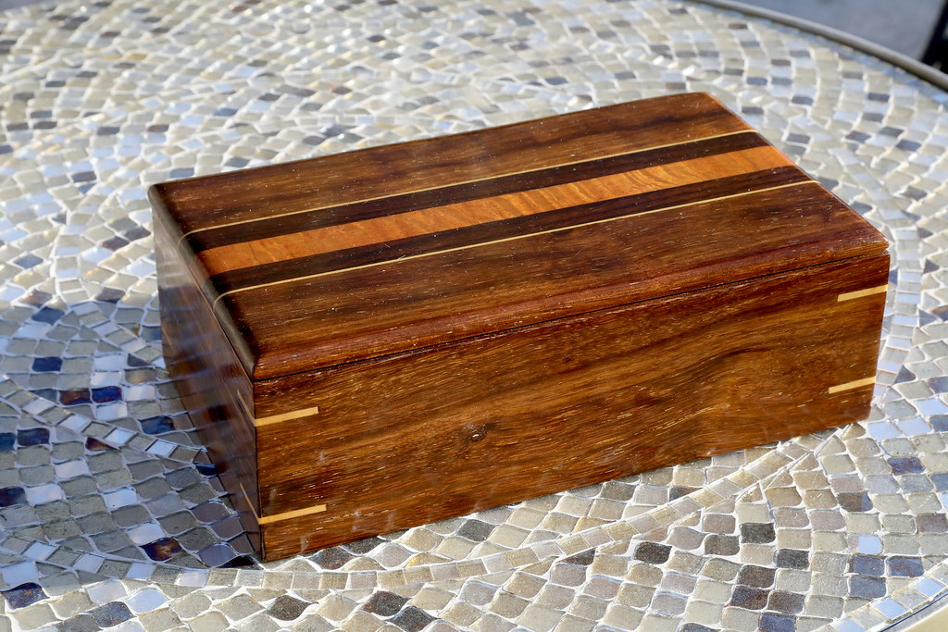
Sensory one on one
Scientific fact: The nerve endings in our skin turn pressure and temperature into sensations we feel because our brains translates environmental stimulation into sensation. Thus providing sensory stimulation provides brain stimulation.
Activity - Make a sensory box. Fill plastic shoebox with rise and everyday objects from rocks to seashells and cups to squeeze balls.
Activity - Gel packs – Fill a Ziploc bag with hand sanitizer, pebbles and glitter. Place inside a second Ziploc. Residents will feel, squeeze and watch the pebbles move inside the bag.

Slide 38
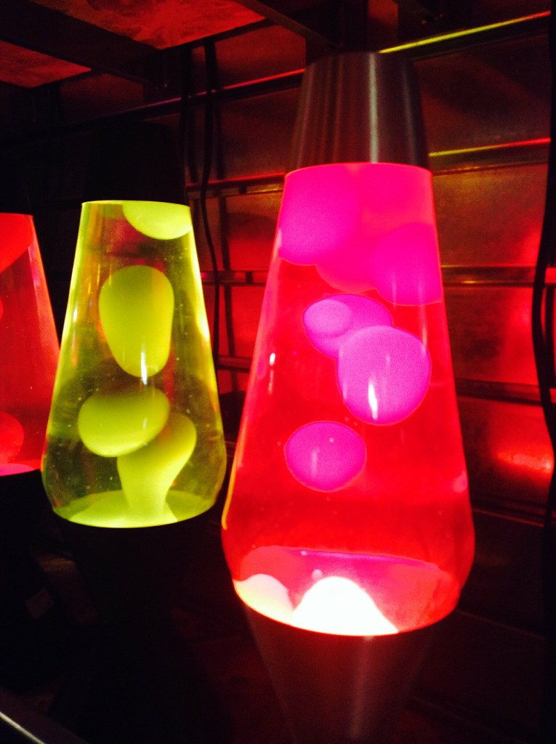
Make a Lava lamp
Materials – empty soda bottle, food coloring, vegetable oil, alka seltzer and water.
1) Fill the bottle ¾ full of oil then add water to the top of the bottle.
Observe: The water will sink into the bottle as clear blobs.
2) Add a few drops of food coloring. The water based food color sinks.
3) Add Alka-Seltzer to the bottle.
Observe: The Alka-Seltzer reacts with the water to produce carbon dioxide gas bubbles. These stick to the water droplets. The water / gas combo is less dense than the oil, so they rise to the top of the flask. At the top, the gas bubbles pop and escape into the air, allowing the dense water to sink back to the bottom again.
A lava lamp light heats it up the oil until it expands and becomes less dense, causing it to rise upward. As it gets farther from the light, it cools down, becoming denser again until it sinks; then the cycle starts all over.

Slide 39
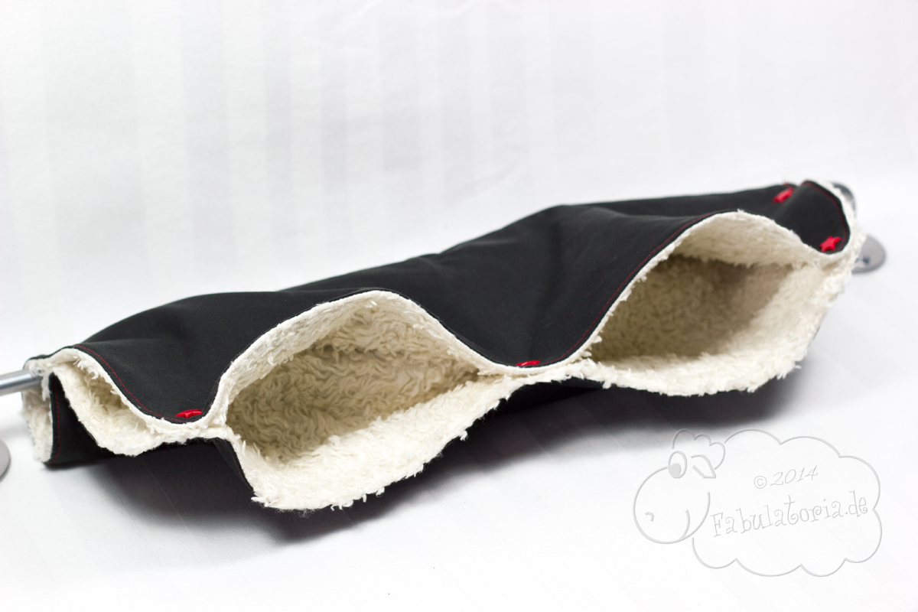
Twiddle Mitt
Bournemouth University in England third year students are making ‘twiddle mitts’ for patients living with dementia at The Royal Bournemouth and Christchurch Hospitals NHS Foundation Trust (RBCH).
‘Twiddle mitts’ are knitted mittens or hand warmers with beads, buttons and objects sewn on to them. The mitts are becoming popular gifts for those living with dementia, as having something to ‘twiddle’ helps to calm agitation and restlessness – both common symptoms of the condition.
Michele Miles, student nurse, said: “I found out about twiddle mitts can vastly improve the mood of people living with dementia.”
Rachael Davies, RBCH dementia nurse specialist, said: “It’s been shown the twiddle mitts can really reduce stress levels for patients with cognitive difficulties.”

Slide 40
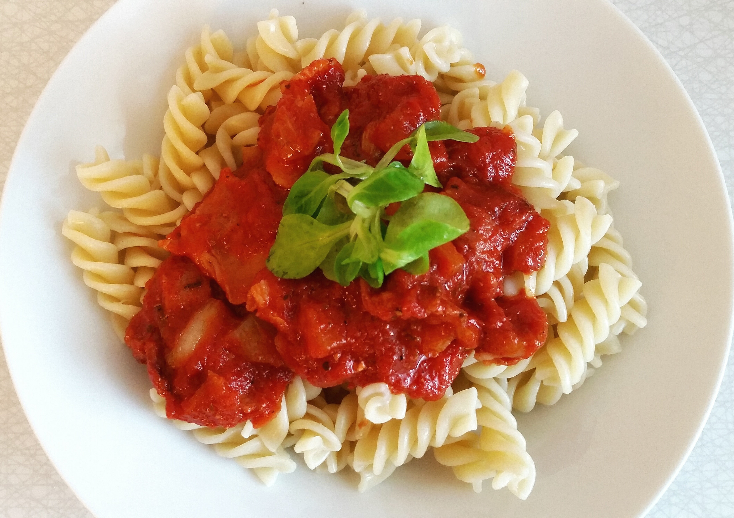
Dinner with Friends
Residents who move from assisted or independent living to memory care often lose friends they made after moving into the community.
Why – fear! Cognitive strong residents see memory care residents struggling and it scares them to think “that could be me”.
Truth, when cognitively strong residents associate with memory care residents it benefits both – friendships.
Dinner with Friends – once a week residents from assisted living join residents in memory care for a meal! Small talk etc. to keep the friendships going in a non-threatening setting.

Slide 42
The Penn FTD Center’s Annual Caregiver Conference
Presentations from leading experts in neuropsychology, clinical care, genetics, cognitive neuroscience, and more, attendees will hear the latest on innovative treatments, diagnostics, and practical caregiver strategies.
Monday, November 13, 2023, at the Smilow Center for Translational Research from 8:30am-3:30pm EST.
PennFTDC@Pennmedicine.upenn.edu with any questions

Slide 43
Gloria Hoffner – Guitarwithgloria@yahoo.com
Scienceforseniors.net

