Slide 1
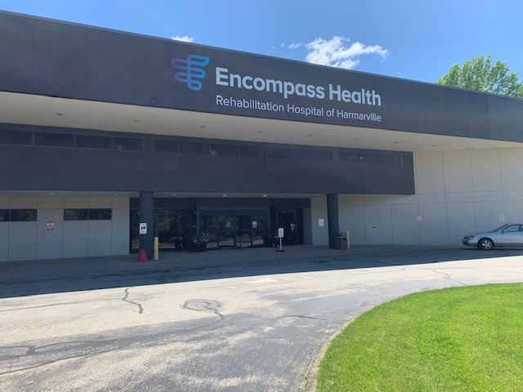
Communication Cognition and Swallowing in Parkinson’s Disease
Pennsylvania Activities Professionals Association
Conference, October 2, 2023
Valerie McCann Bucek, MA CCC-SLP/L
Therapy Manager
Encompass Health Rehabilitation Hospital of Harmarville
Encompass Health | Confidential information

Slide 2
Encompass Health Rehabilitation Hospital of Harmarville
Joint Commission Certified Inpatient Parkinson’s Disease Program:
Neurofocused comprehensive treatment
Physician directed interdisciplinary team approach
Follows evidence-based Clinical Practice Guidelines
Staff trained in Specialized Parkinson’s Disease Treatment approaches
Certified Rehabilitation Registered Nurses
Parkinson’s Support Group (in person)
PWR-PLUS Community Exercise Program on Zoom
Parkinson Voice Project Grant recipient each year since 2019

Slide 3
Communication Difficulties in Parkinson's Disease have Motor and Cognitive Aspects.
Some Definitions
Communication is the active process of exchanging information and ideas through verbal and non-verbal means.
Non-verbal means can include – body movements, facial expressions, gestures.
Speech refers to how people say words and sounds.
Speech production includes:
Articulation
Voice
Fluency
Language – A system of conventional symbols that are used to express thoughts, ideas and emotions.

Slide 4
Up to 90% of individuals diagnosed with PD are likely to develop speech disorders during the course of their illness potentially seriously affecting their intelligibility.
Ho, A., Iansek, R., Marigliani, C., Bradshaw, J.L., Gates, S. (1998), Speech Impairment in a large sample of people with Parkinson's disease. Behavioral Neurology 11, 131-137.
Perez-Lioret, S., Negre-Pages, L., Ojero-Senard, A., Damier, P., Destee, A., Tison, F., Merello, M., Rascol, O. (2012). Oro-buccal symptoms (dysphagia, dysarthria, and siaiorrhea) in patients with Parkinson's disease: preliminary analysis from the French COPARK cohort. European Journal of Neurology, 19, 28-37.

Slide 5
Speech Disorder Most Common in Parkinson's Disease
Hypokinetic Dysarthria
Reduced pitch variation
Reduced vocal volume
Breathy voice – “Fading”
Imprecise articulation
Variable speaking rate

Slide 6
Hypokinetic Dysarthria –
Is caused by a malfunction in the brain’s extrapyramidal system, that controls subconscious or automatic muscle movements.

Slide 7
The more popular evidence based therapy approaches focus on bringing some aspect of speech production under volitional control.

Slide 8
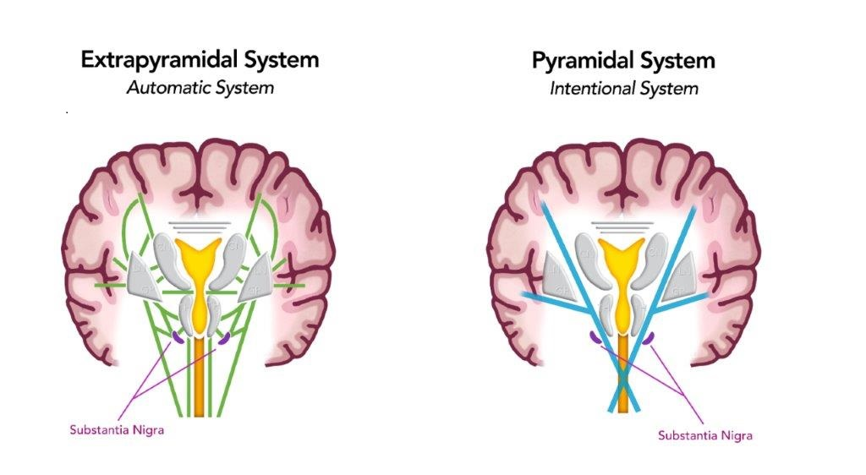

Slide 9
ATTENUATION IS KEY!
Patients with Parkinson's Disease perceive that they are speaking louder than they actually are.

Slide 10
LEE SILVERMAN VOICE TREATMENT
Evidence-based approach developed by Lorraine Ramig.
Named for patient with Parkinson's Disease who funded ongoing research.
Focus on sensory “re-calibration”.
LSVT Global established in 2003.

Slide 11
COMPARISON OF LSVT WITH SPEAKOUT!
 | LSVT | SPEAKOUT!
Research Supported | Yes | Yes
# Treatment Sessions | 16 | 12
Days per week | 4 | 3
Session Length | 60 minutes | 45 minutes
Home Program | Exercises | Workbook with daily tasks
Usually covered by Medicare | Yes | Yes
Treatment Focus | Highly structured focus on being LOUD and sensory calibration | More flexible program focus on using intent. Incorporates cognition
Group therapy component maintenance | No | Yes

Slide 12
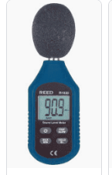
SOUND LEVEL METER
Important tool is raising awareness of vocal volume and ability to control it.
Used in LSVT and SPEAK OUT!
Apps available on phone for self-monitoring.

Slide 13
SPEAK OUT!
SPEAK OUT!
Is an evidence-based speech therapy treatment approach developed by the Parkinson's Voice Project.
Enables people with Parkinson's Disease to regain and maintain speaking abilities.
Utilizes principles of motor learning and activity dependent neuroplasticity.

Slide 14
SPEAK OUT! Program
Speech Evaluation
12 therapy sessions (typically)
Each session has 6 components/exercises aimed at strengthening muscles used in speech and swallowing
25 lesson workbook for home practice

Slide 15
“Intent” is the focus of treatment
Discovered in the 1950’s by Daniel Boone, Ph.D.
Addresses the disruption of automatic movements caused by dopamine depletion.
Speaking with purpose and deliberation may improve vocal volume and speech clarity.

Slide 16
Weekly Speech Therapy Groups
Helps to maintain the improvements gained through SPEAK OUT!
Weekly speech therapy group focusing on voice exercises learned in SPEAK OUT!
Daily individual home practice
Periodic re-evaluations/refreshers

Slide 17
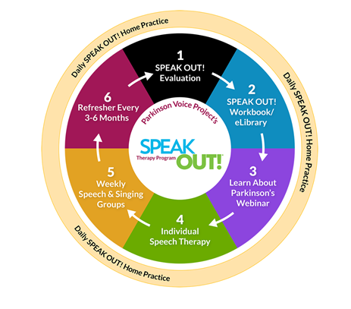

Slide 18
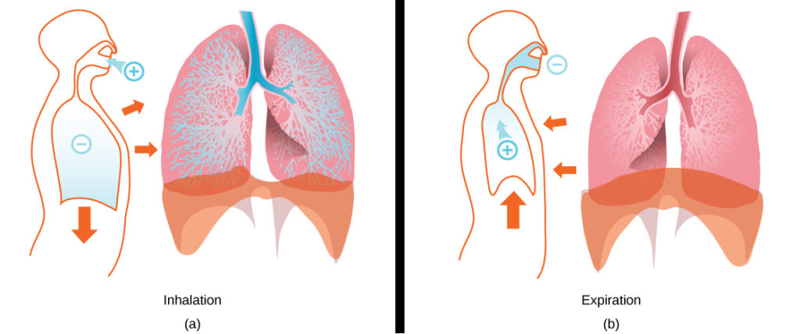
Breath Support for Speech and Swallowing
Traditional: Diaphragmatic breathing
Voicing on exhalation

Slide 19
Respiratory Muscle Training
Uses simple resistance device
Improve breath support = more syllables per breath
Strengthen voice
Normalize lung volumes

Slide 20
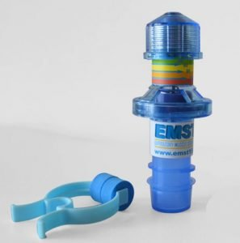
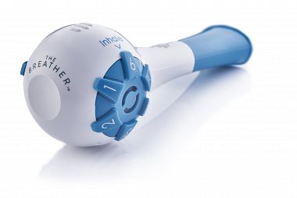
EMST = Expiratory Muscle Strength Training or The Breather – Respiratory Muscle Trainer
Trains inspiratory and expiratory muscles.
Multiple settings.
Single patient use: cost $50.

Slide 21
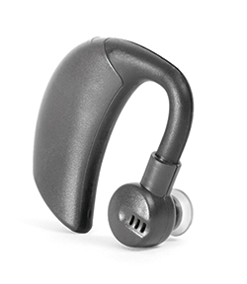
Compensation
Speech Vive
A wearable Speech Aid.
Utilizes “Lombard Effect”.
Provides background noise into ear prompting the patient to speak louder.
Covered by Medicare, VA and most private insurances.
Alternative to therapy.
Individually calibrated.

Slide 22
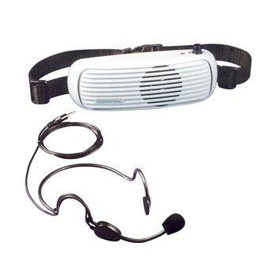
Compensation
Voice Amplifier
Increases speakers volume.
Various systems – lapel, collar, hand held microphones with various price ranges.
May be covered by insurance.

Slide 23
AAC
Augmentative and Alternative Communication
Refers to all the ways someone communicates besides talking.
Used by people of all ages who have difficulty speaking.
Augmentative Communication means to supplement or add to someone’s speech .
Alternative Communication means to be used instead of speaking.

Slide 24
AAC can be:
No Tech: gestures; writing, pointing to letters, words or pictures.
Low Tech: using a phone application.
High Tech: Using a speech generating device – computer with a voice.

Slide 25
Examples of AAC used with Parkinson's:
No Tech: Pacing board, alphabet board
Low Tech: Smart phone or tablet. Applications such as Alpha topics AAC, Conversation Pace board.
High Tech: Speech generating devices from Lingraphica, Dynavox, IPad based devices.

Slide 26
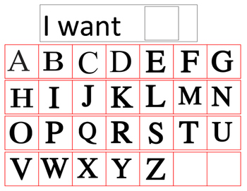
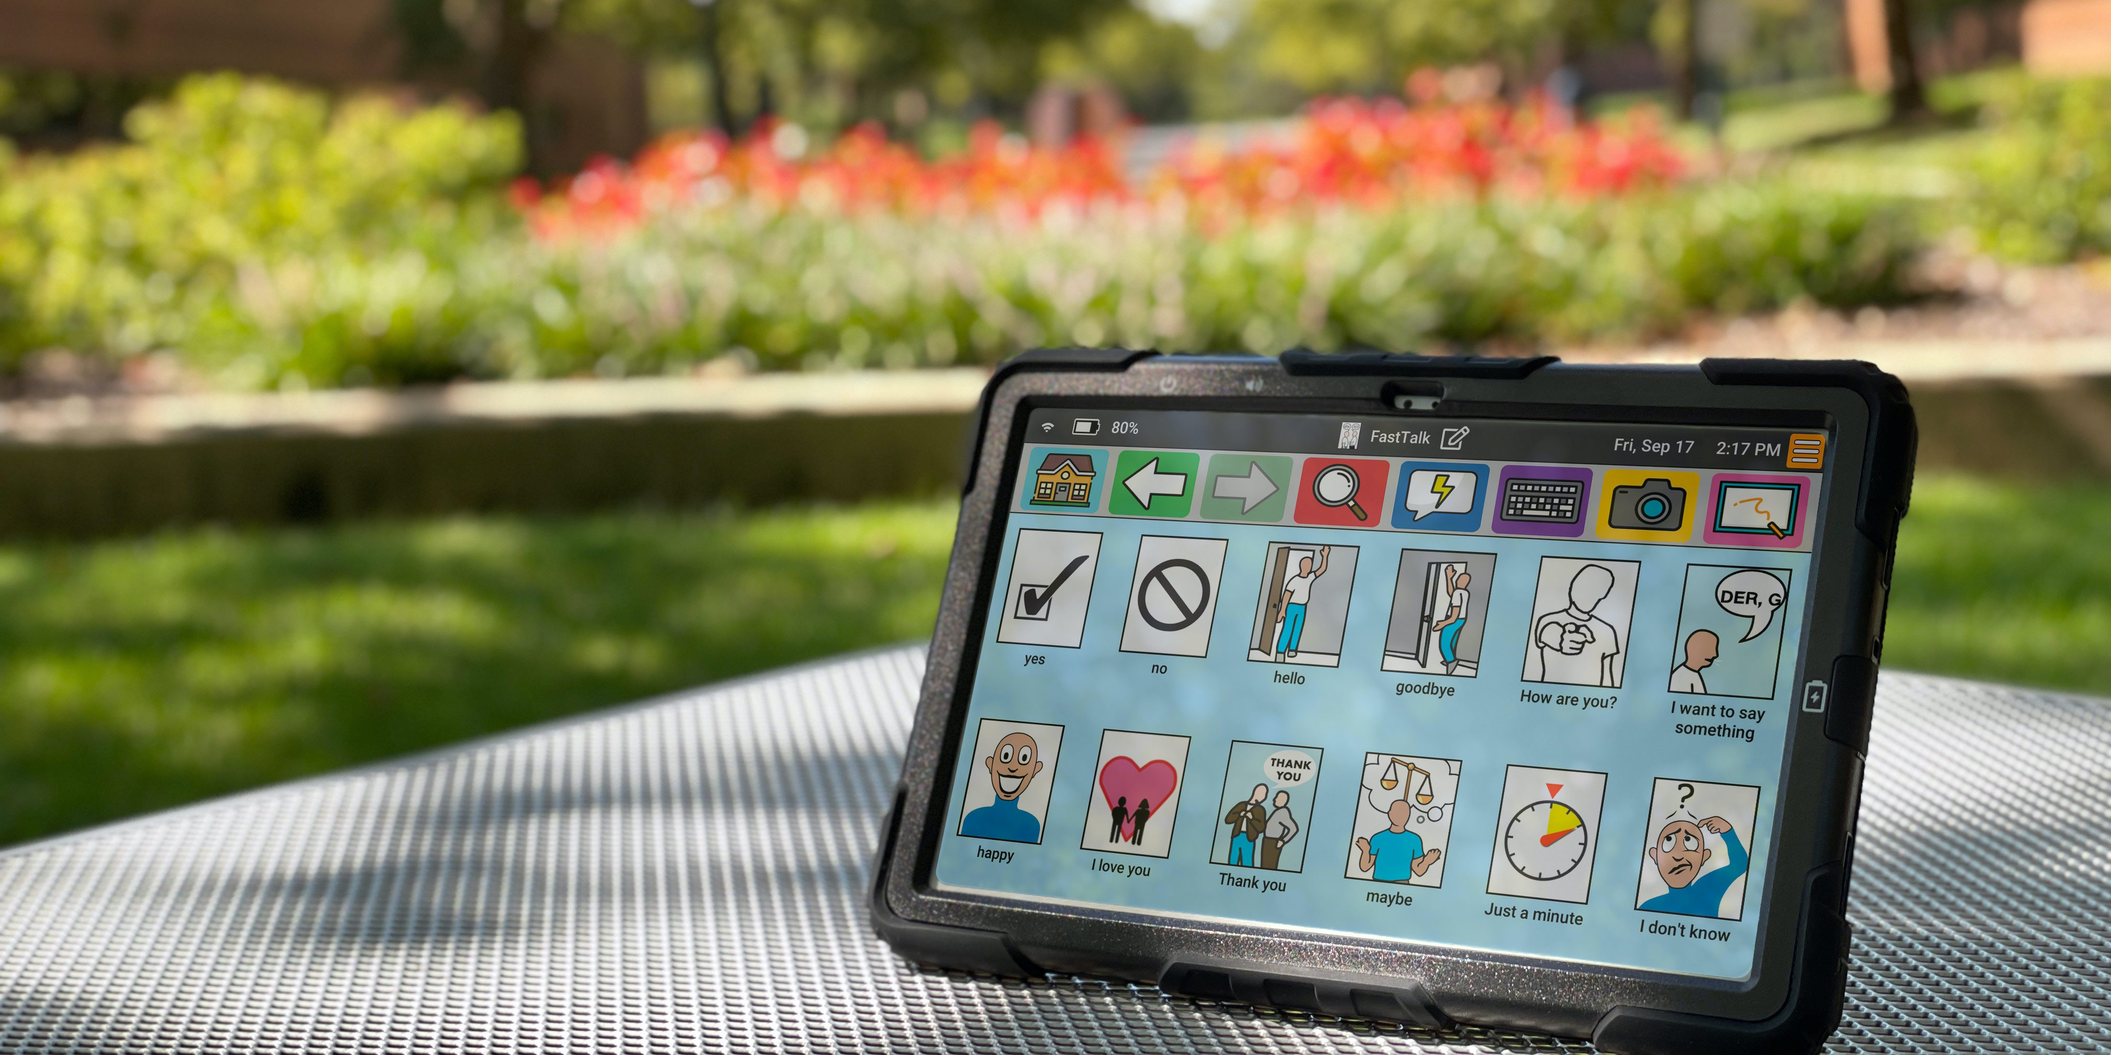
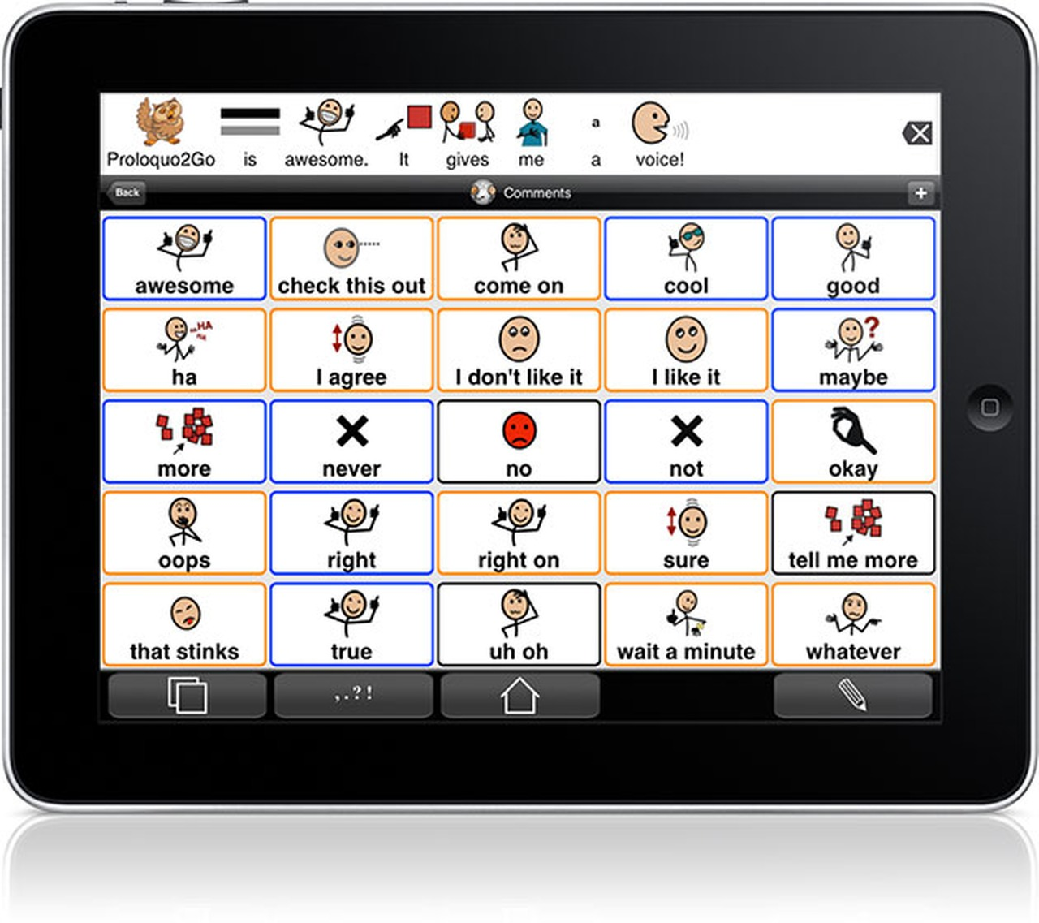

Slide 27
Cognitive Communication
Mild Cognitive Impairment (MCI) is recognized as a transitional state between normal cognition and dementia.
Approximately 30 – 40% of Parkinson's patients show mild cognitive impairment.

Slide 28
New research from Parkinson's Society – Canada reveals in 5% of people, cognitive changes precede onset of motor symptoms.
Perception of Parkinson's Disease has changed from a motor disorder to a complex brain disease.

Slide 29
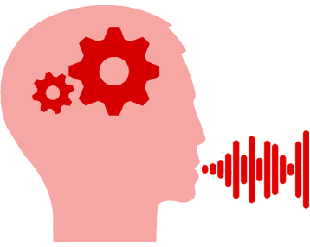
Parkinson's Disease Impact on Linguistic Skills

Slide 30
Language Structure:
Difficulty comprehending complex auditory and written information.
Difficulty making inferences.
Language production is less ”rich” using simplified sentence structure.

Slide 31
Attention is:
The ability to focus on one aspect of the environment while ignoring others.

Slide 32
Difficulty with attention can be manifested as:
Difficulty concentrating on a task.
Difficulty ignoring distractions.
Difficulty following a group conversation.
Difficulty doing two things at the same time, i.e. walking and having a conversation.
Difficulty shifting from one task to another.
Difficulty encoding, storing and retrieving information.

Slide 33
Memory strategies ITRAVEL
I = IMMEDIACY
T = TOOLS
R = ROUTINE/REHEARSAL
A = ASSOCIATION
V = VISUAL IMAGERY
E = ENVIRONMENT
L = LISTEN AND ATTEND

Slide 34
Word Retrieval Difficulty
“Tip of your tongue” phenomena.
Is a part of normal aging.
More prominent in people with MCI.

Slide 35
Word Retrieval Difficulty
Misnaming objects.
“Finding the right words”.
Difficulty generating words.
Vague or rambling.
Verbal pauses.

Slide 36
Word Retrieval Strategies
Visualize.
Associate.
Describe.
Word Retrieval Compensation
Drawing.
Writing.
Word list.
Smart phone.

Slide 37
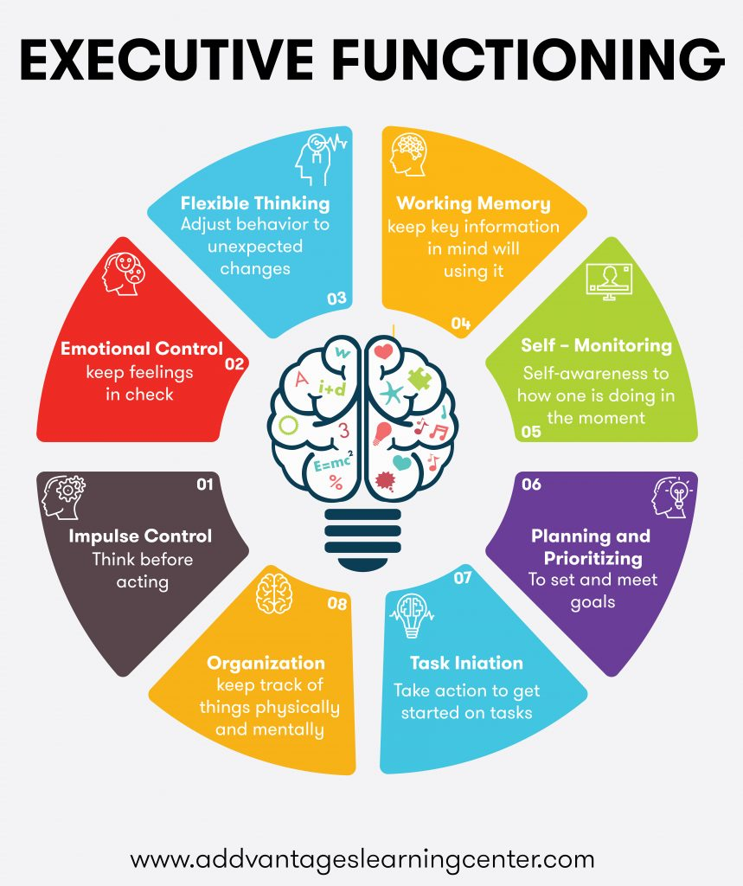
Executive Function:
A broad group of skills that enable people to complete tasks and interact with others.
A set of cognitive processes necessary for the cognitive control
of behavior.

Slide 38
Executive Function tasks involve:
Working memory.
Cognitive flexibility.
Inhibitory control.
Thought organization.

Slide 39
Examples of Executive Function Skills:
Adaptable/flexible thinking.
Organizing, planning, prioritizing.
Working memory.
Self-control/self-monitoring.
Time management.
Task initiation/completion.

Slide 40
Emotional Processing
Impacts communication
Masked facial expression has cognitive component – not just rigidity.
Difficulty perceiving emotion in others including facial expression, inflection and words related to emotion.

Slide 41
Social Communication/Pragmatics
Difficulty initiating conversation/topics.
Maintaining topics/conversation.
Using referents.
Drawing conclusions.
Social distance/familiarity.
Impact of mood on communication/cognition.
Depression/apathy.
Medication side effects.

Slide 42
Communication Partner Training
Improves communicative access and participation for the patient and caregiver.
Increases significant other’s awareness of how their own communication behaviors that facilitate or limit patient’s communication.
Education on practical strategies to improve communication.

Slide 43
DYSPHAGIA
Medical term for swallowing difficulty.
Incidence of Dysphagia in Parkinson's Disease is very high – more than 80%.
Related to muscle weakness and discoordination.
Often variable – related to “off” times.
Worsens as disease progresses.

Slide 44
Aspiration occurs when food or liquid enters a person’s airway and eventually the lungs.
Aspiration pneumonia has been reported as most frequent cause of death in PD patients, and has been estimated to account for 70% of the mortality.
Mehanna R., J. (2010). Respiratory problems in neurologic movement disorders. Parkinsonsism and Related Disorders, 16, 628-38. dol: 10.1016/ j.parkreldis.2010.07.004

Slide 45
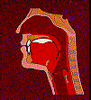
Swallowing Phases
Oral preparatory – salivation and mastication.
Oral- voluntary transfer of bolus into oropharynx.
Pharyngeal – involuntary movement from oropharynx to esophagus.
Esophageal – involuntary movement through the esophagus to the stomach.

Slide 46
Symptoms of Dysphagia
Difficulty chewing.
Coughing or choking when eating or drinking.
Increased secretions, persistent drooling.
Wet, gurgly vocal quality.
Sensation of food sticking in the throat (Globus)
Inability to swallow.
Regurgitation into mouth or nose.
Pain with swallowing.
Hoarseness.
Frequent heartburn.

Slide 47
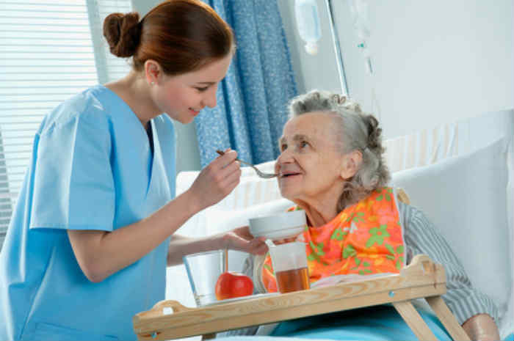
Dysphagia Evaluation
● Traditionally called “Bedside Swallow Evaluation”.
Patient interview/Review of history.
Oral motor examination.
Observation of patient eating (mealtime is best).
Recommendations for diet level, strategies and instrumental assessment as appropriate.

Slide 48
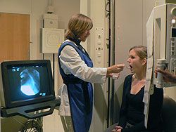
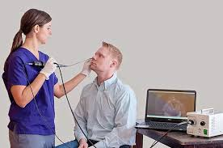
Common Instrumental Assessments
MBS – Modified Barium Swallow.
FEES – Fiberoptic Endoscopic Evaluation of Swallowing.

Slide 49
MBS
Videofluroscopic evaluation of oral preparatory, oral and pharyngeal phases of the swallow.
Detects aspiration before, during and after the swallow.
Still considered “Gold Standard” in swallowing evaluation.
Can screen esophagus.

Slide 50
FEES Procedure
SLP or physician passes a flexible endoscope through the patient’s nose.
Swallowing is assessed with different food and liquid consistencies.
More accessible, less expensive than MBS.
“White out” period during swallow.
Does not assess oral phase or screen esophagus.
Better view of residue.

Slide 51
Dysphagia Treatment Prescribed by Assessment
Alteration of food/liquid consistencies.
Strengthening/coordination exercises.
Modalities – Vital Stimulation.
Compensatory strategies.
Equipment – safe straws, provale cups.

Slide 52
Straw vs no straw

Slide 53
Safe Swallow Strategies
Sit upright while eating or drinking, including pills.
Take small sips; one sip of beverage at a time.
Take small bites.
Chew thoroughly.
Swallow “HARD” and “FAST”.
Eat slowly. Put fork down between bites.
Consider impact of hand to mouth skills.

Slide 54
Safe Swallow Strategies
Alternate solids and liquids. The liquids will help to rinse the solid particles from your mouth.
Swallow multiple times, as needed, to clear each bite.
Use your tongue to “sweep” your mouth and get any food particles left in your mouth.
Avoid distractions while eating or drinking.
Do not talk with food or beverage in your mouth.

Slide 55
Questions?

Slide 56
sources
American Speech Language and Hearing Association. www.asha.org
American Parkinson's Disease Association. apdaParkinson's.org “Make your voice heard! Healthy Communication and Parkinson's Disease”.
Parkinson's Voice Project. www.Parkinson'svoiceproject.org
Lee Silverman Vice Treatment. www.lsvtglobal.com
Parkinson's Society Canada. Parkinson'spost.com “Cognitive Changes can Affect Communication in Parkinson's”.
Tactustherapy.com “Nine Ways to Improve Speech in Parkinson's Disease”.
Voiceaerobicsdvd.com “He Mumbles – She can’t here”. “Communication Partner Training in Parkinson's Disease”.
https://ernst150.com/health-conditions/Parkinson'ssdisease “EMST 150 for People with Parkinson's Disease”.
ALIMED.com

Slide 57
sources
“The Impact of Expiratory Muscle Strength Training on Speech Breathing in Individuals with Parkinson's Disease”. Darling-White, Meghan, Huber, Jessica E. American Journal Speech – Language Pathology, vol. 26, Nov. 2017.
“Expiratory Muscle Strength Training for Therapy of Pharyngeal Dysphagia in Parkinson's Disease”. Claus, Inga; Munle, Paul; Czechowski, Judith, et al. Movement Disorders, vol. 36. No. 8, 2021.
“Parkinson's Disease Mild Cognitive Impairment (PDMCI): A Useful Summary of Update Knowledge”. Davide, Maria Cammisuli; Commisuili, Salvatore; Pruneti, Carlo. Front Aging Neuroscience. Vol. 11, 2019.
“Cognitive Decline in Parkinson's Disease, the Impact of Motor Phenotype on Cognition”. Wojtala, J.; Heber I.A.; Neuser P.; Heller, J.; Kalbe J.; Rehberg S.P. et al. Journal Neurology, Neurosurgery, Psychiatry 90-171-179.
Communication Impairment in Parkinson's Disease: Impact on Motor and Cognitive Symptoms on Speech and Language. Smith, Kara; Caplan, David N. Brain Language 2018 October 185-38-46.

Slide 58
sources
VPSS and FEES: “The Gold Standard Debate”. Carmin Bartow and Amanda Hereford, Vanderbilt University Medical Center 2020.
The Breather – General Protocol. www.PNmedical.com

