Slide 1
Nerf Madness
Johan Naranjo, ADC, CDP

Slide 2
Nerf in Nursing Homes: A Starting Point

Slide 3
Questions
physical benefits might the residents be receiving from the activity?
What cognitive/emotional benefits might the residents be receiving as well from the activity?
What potential issues might staff members face when conducting this activity? And what problems do you see?

Slide 4
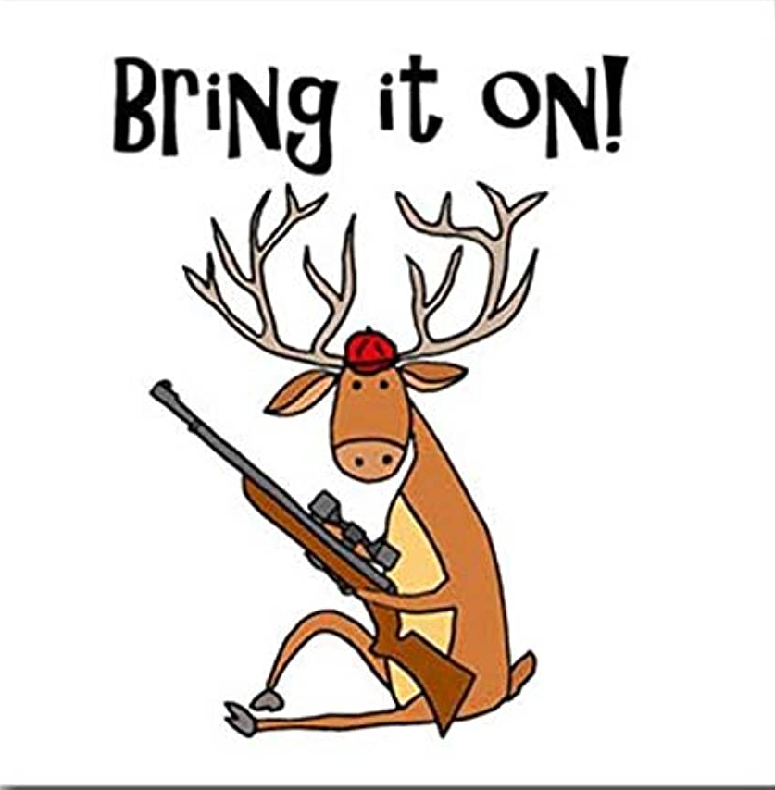
My Response to the Deer Hunting activity
Tons of preparation with a brief pay off
Safety concerns (which we will discuss more)
Pandoras Box

Slide 5
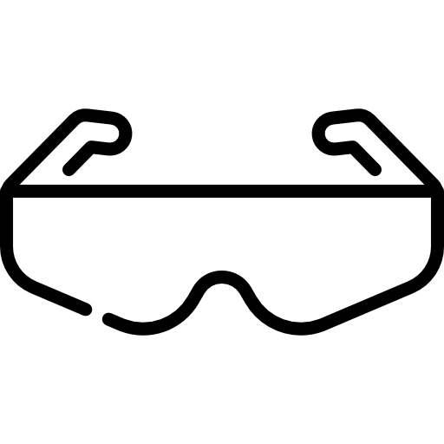
Pointers for Running Nerf Fun
Safety:
Goggles
Distancing between action & spectators
Handling & Firing power
Preparation:
Types of Blasters
Preload Blasters
Training:
Staff orientation
Resident’s partnership with staff members

Slide 6
Time to Play!
Benefits of Stationary vs Moving targets

Slide 7
How do our residents' benefit?
Physical Benefits
Hand-eye coordination
Arm extension
Light lifting
Cognitive/Emotional Benefits
Sense of accomplishment
Power of laughter
Concentration
Builds community

Slide 8
Benefits of Theming
Themes draw people in & get them out to the activity
Stimulates the imagination
Gives residents something to look forward to

Slide 9
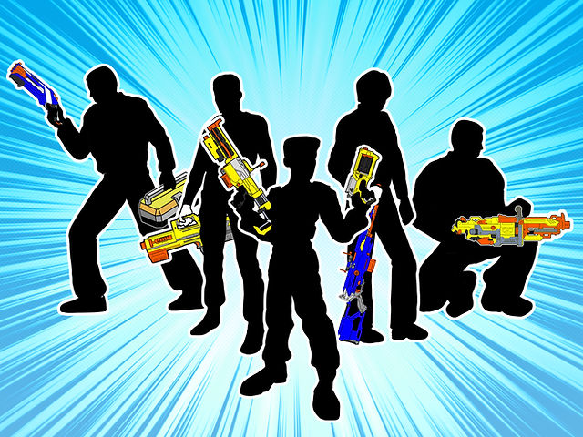
The Plan’s Coming Together!
Title or Theme
Safety
Materials
Set up
Play Procedure

Slide 10
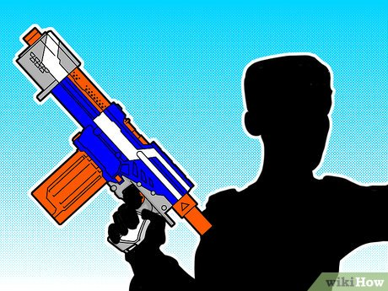
Review
Nerf’s history in Activities
Safety
Benefits
Theming
Planning

Slide 11
Thank you! Questions?
Sources
Hasbro Nerf Product Guide
Personal Experience

