Slide 1

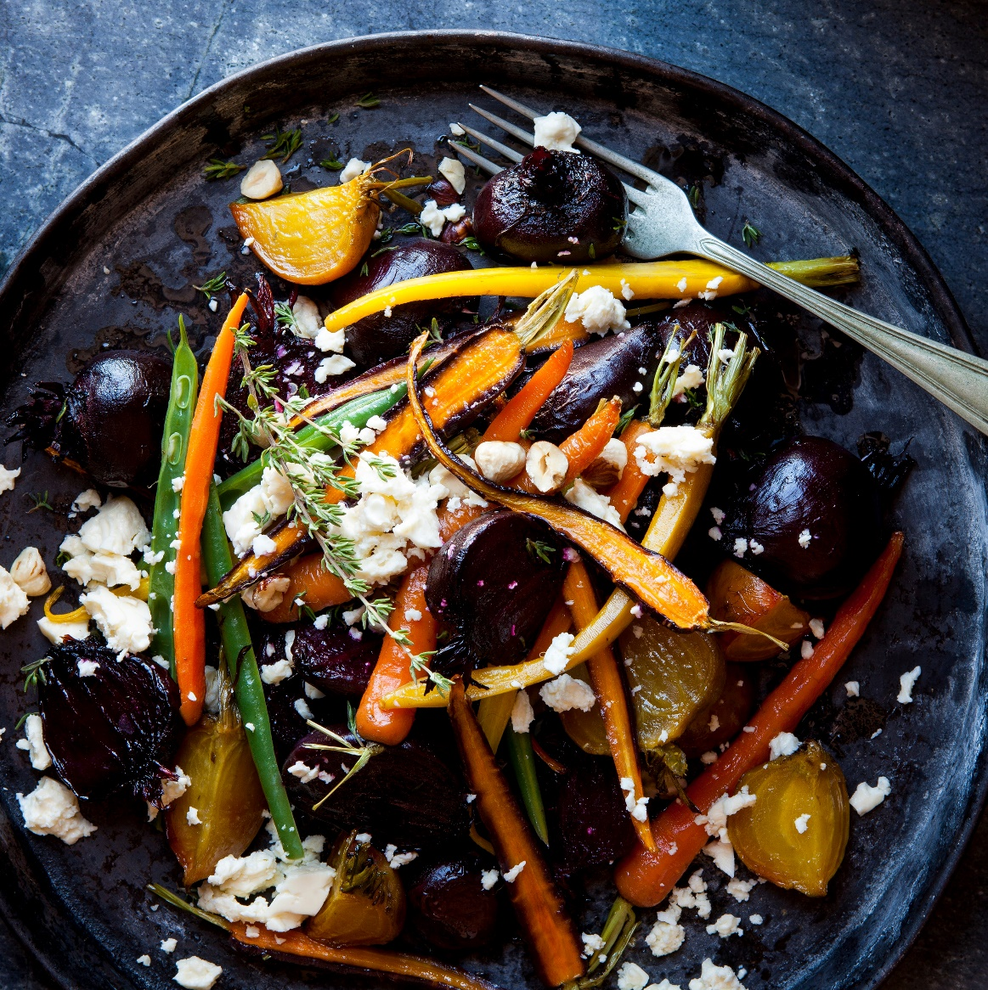
Food for Thought
BY Joan M. Edel BA, ADC

Slide 2

Our Whole World Revolves Around Food

Slide 3
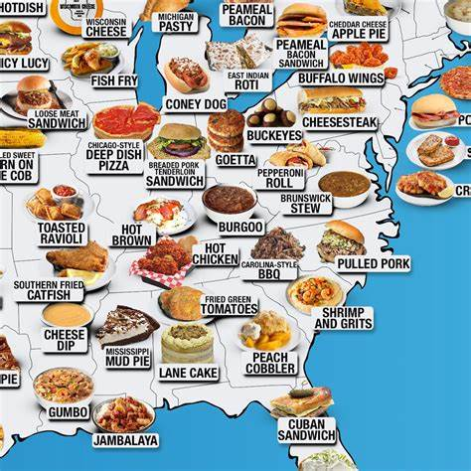
Look at all the varieties of food in only a cross section of our country.

Slide 4
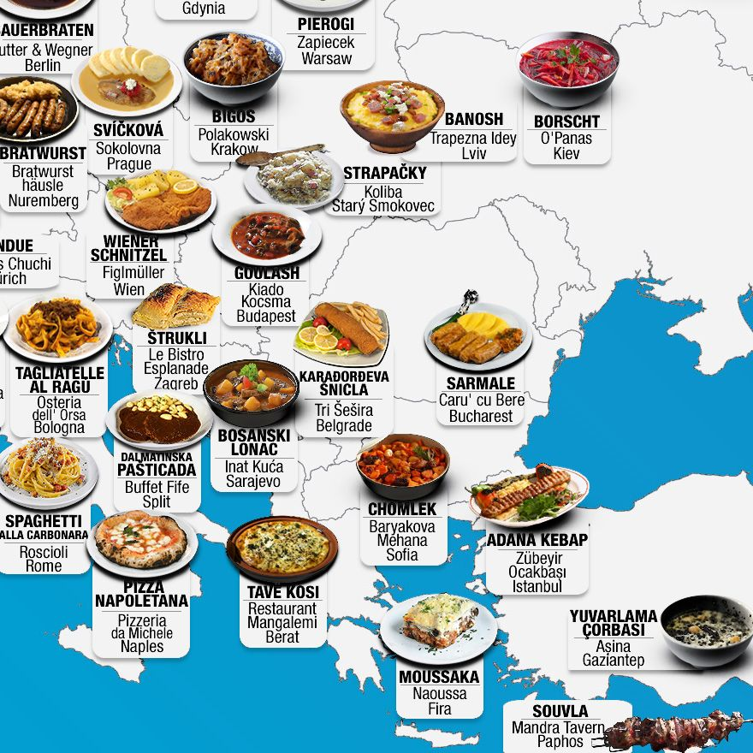
This only a small view of the variety of foods available around the world.

Slide 5
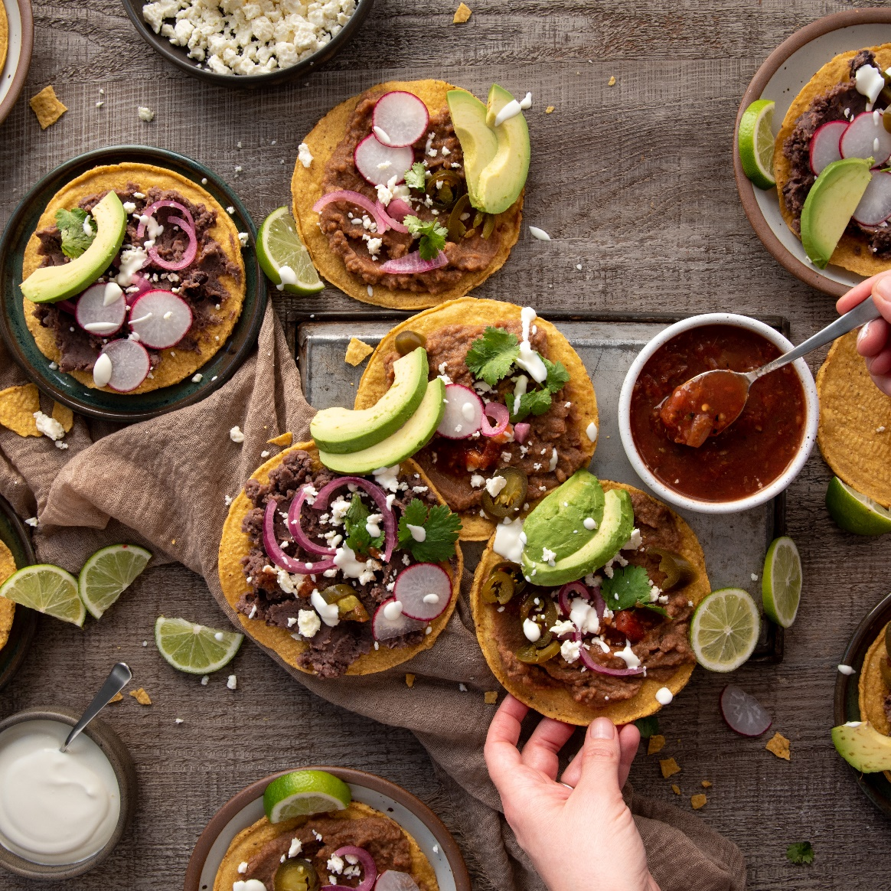
We must Eat to Live, Some of us Live to Eat!

Slide 6
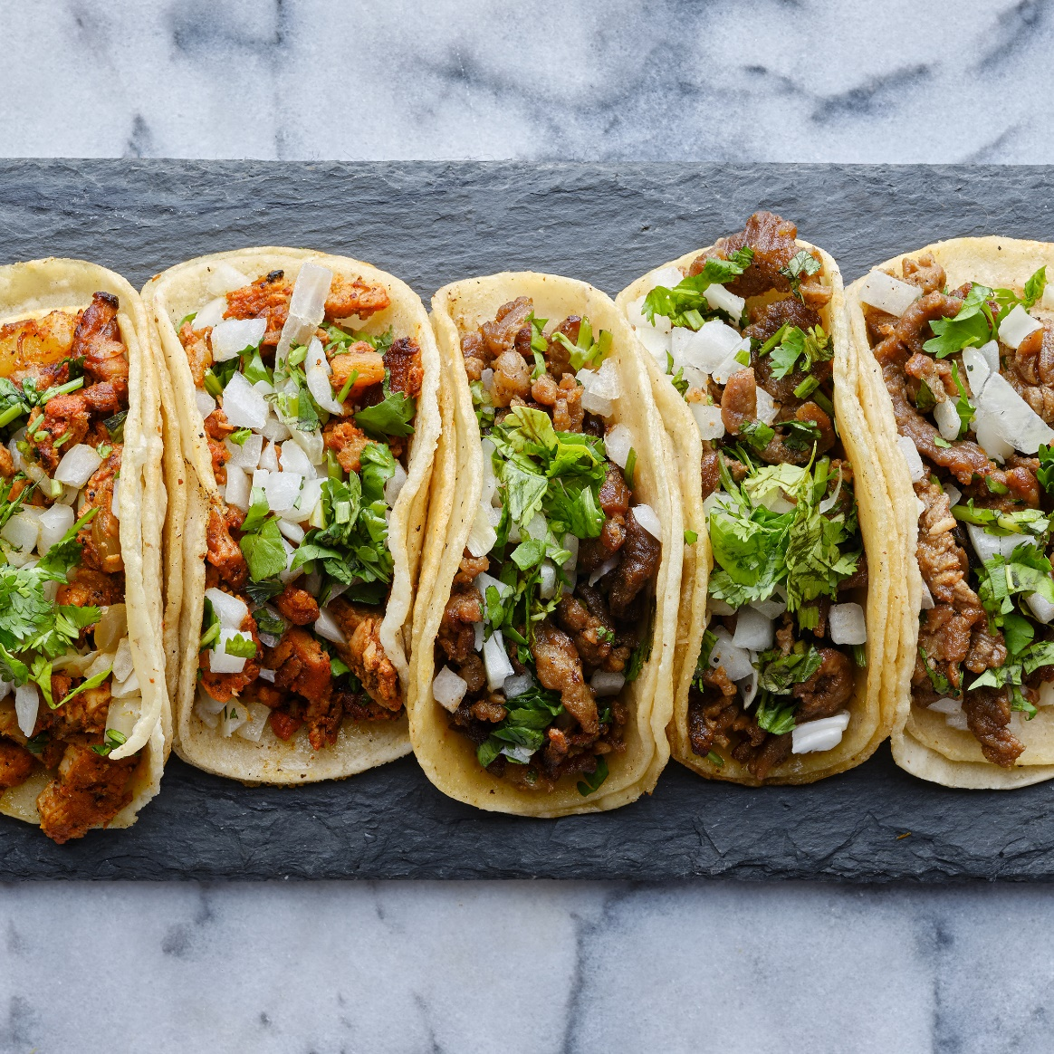
Allergies and Special Diets

Slide 7
Shell Fish Milk Peanut TreeNut Fish
Most Common Food Allergies Adults

Slide 8
To Encourage Weight Loss To Encourage Weight Gain Low or no Sugar (Diabetic) Low or no Salt (Heart Related Issues) Low Fat (Cholesterol Issues) Fluid Restrictions (Kidney Disease) Modified Consistency
Special Diets
And the list goes on………………

Slide 9

Food Plans can only be approved by the residents Licensed Health Care Professional
DISCLAIMER

Slide 10
Our Relationship with Food
Food Attitudes

Slide 11

CHOCOLATE
My Curse and My Blessing

Slide 12

We are not licensed Therapist/Psychiatrists but it is good to be in tune with our own attitudes and relationships with food as well as our residents.
DISCLAIMER
This Photo by Unknown Author is licensed under CC BY-NC-ND

Slide 13
FOODS
HEALTH
HELP
HEAL

Slide 14

This Photo by Unknown Author is licensed under CC BY
CINNAMON

Slide 15

This Photo by Unknown Author is licensed under CC BY
A TASTE OF HONEY

Slide 16

EYE HEALTH

Slide 17

H2O WATER

Slide 18
Disclaimer:
Before consuming large amounts of water consult with your Primary Care Physician as certain medical conditions have water restrictions.

Slide 19
Plastic Water Bottles if Frozen or Left in the Heat will release chemicals into your water so be careful with your storage and cooling techniques.

Slide 20

This Photo by Unknown Author is licensed under CC BY-SA
EVIL SUGAR

Slide 21
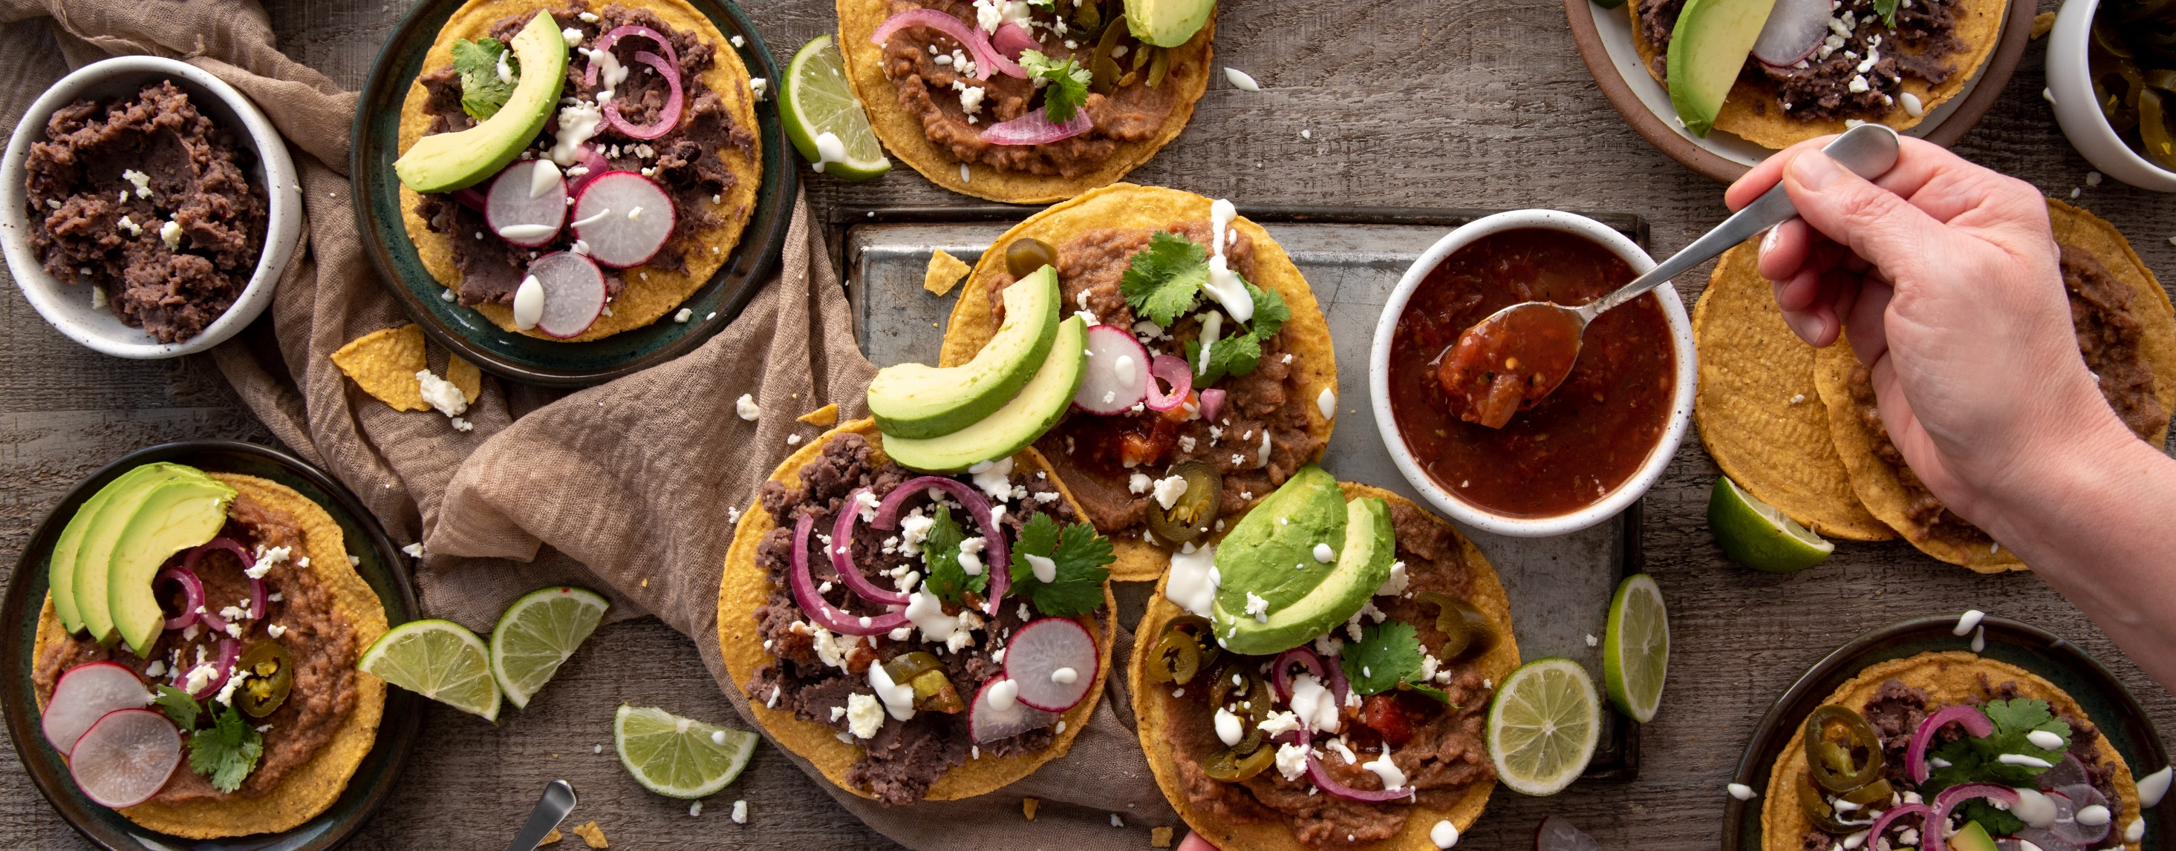
Bon appétit
Joan M Edel
Pike County Aging
150 Pike County Boulevard
Hawley PA 18428
Cell # 973-229-9871

