Slide 1




Guess Who the Women of the Bible

Slide 2
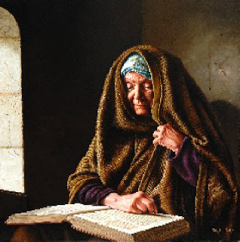
An aged Jewish prophetess who prophesied about Jesus at the Temple of Jerusalem. Luke [20]

Slide 3
Anna

Slide 4
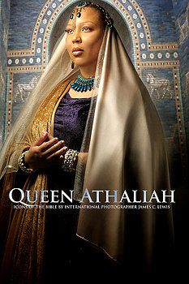
Queen of Judah during the reign of King Jehoram, and later became sole ruler of Judah for five years. II Kings, II Chronicles [23] [24]

Slide 5
Queen Athaliah

Slide 6
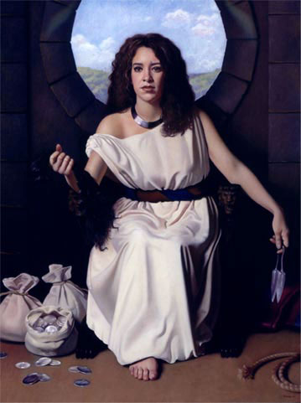
The "woman in the valley of Sorek" whom Samson loved, and who was his downfall. Judges [40]

Slide 7
Delilah

Slide 8
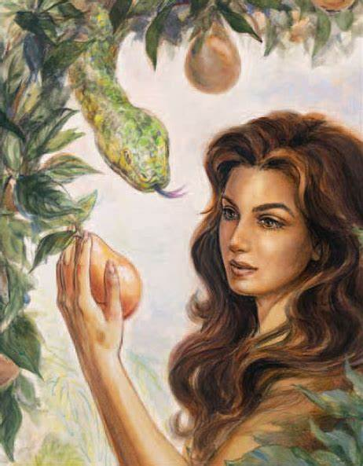
She is the first woman of the bible
She was made of another's rib
She was tricked into eating a fruit
And she is the first mother of the bible as well.
Who is she?

Slide 9
EVE

Slide 10
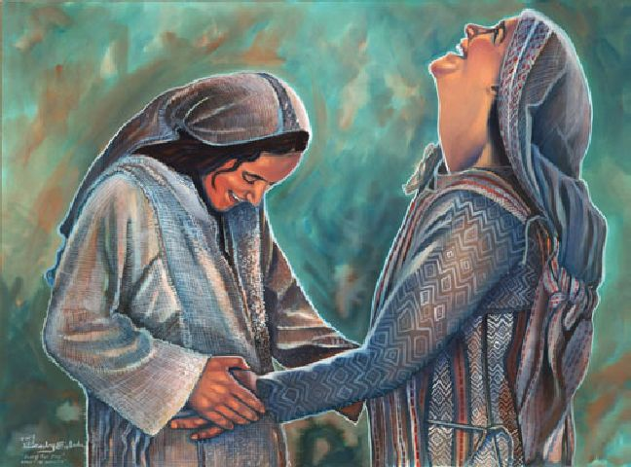
- Mother of John the Baptist and the wife of Zacharias. Luke [44]

Slide 11
Elisabeth

Slide 12
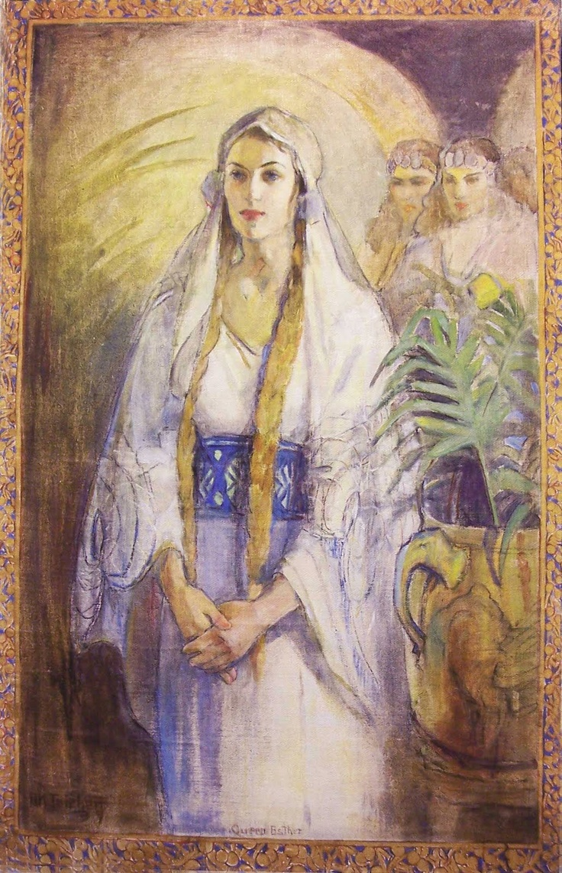
Queen of the Persian Empire in the Hebrew Bible, the queen of Ahasuerus. In the Book Named after her.

Slide 13
Esther

Slide 14
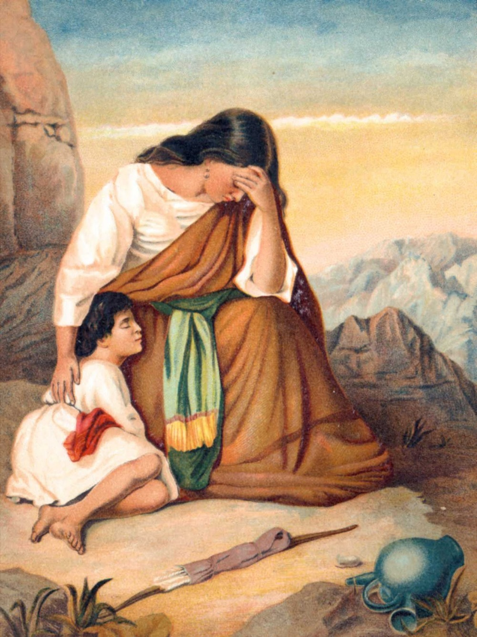
Egyptian handmaiden of Sarah, wife of Abraham. She then became the mother of Abraham's son, Ishmael. Genesis [50]

Slide 15
Hagar

Slide 16
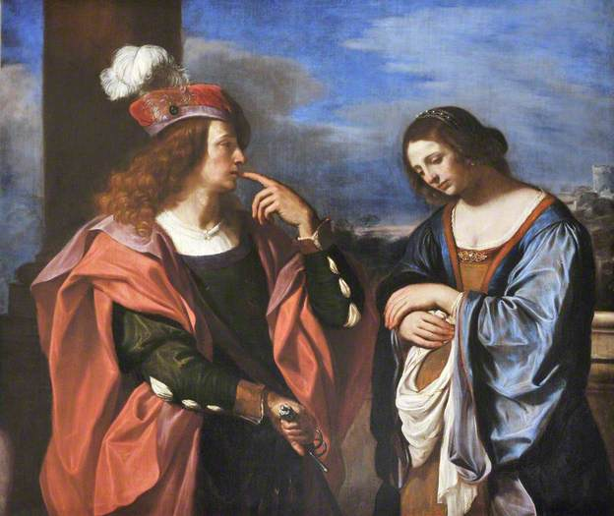
Wife of King David, mother of Adoniyah II Samuel, I Kings, I Chronicles [51] [52] [53]

Slide 17
Haggith

Slide 18
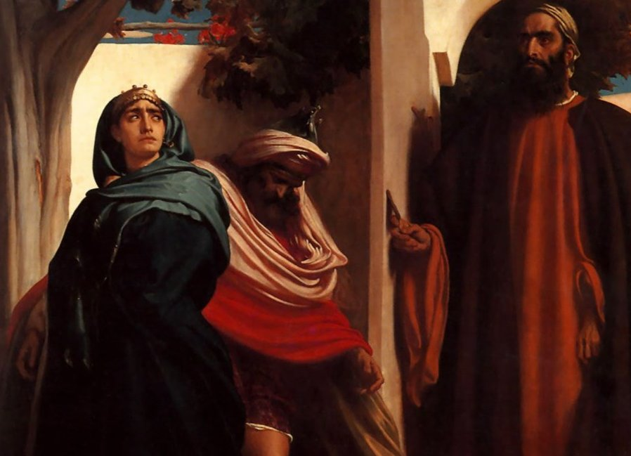
Wife of wicked king Adaiah and mother of Josiah. II Kings [75]

Slide 19
Jedidah

Slide 20
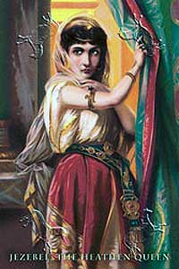
Queen of ancient Israel. I Kings, II Kings [84] [85]

Slide 21
Jezebel

Slide 22
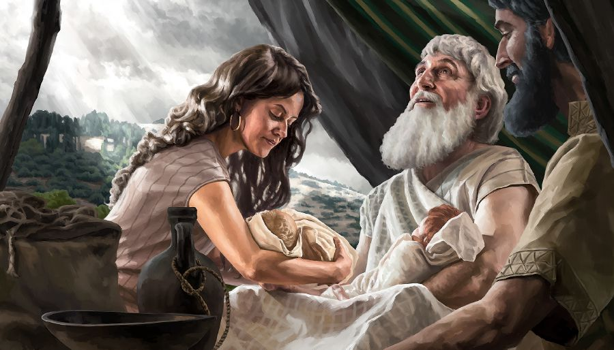
Hittite wife of Esau Genesis [88]

Slide 23
Judith

Slide 24
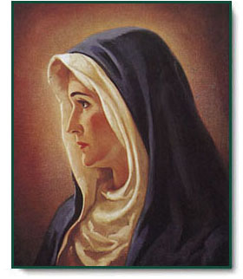
Mother of Jesus

Slide 25
Mary

Slide 26
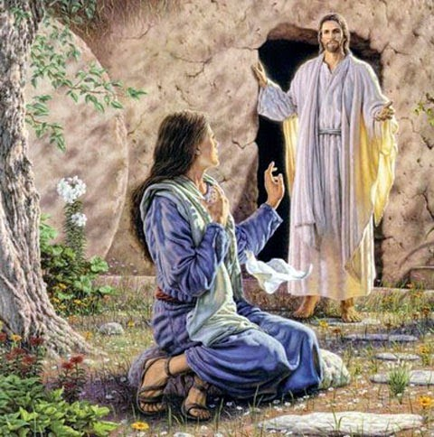
Disciple of Jesus

Slide 27
Mary Magdalene

Slide 28
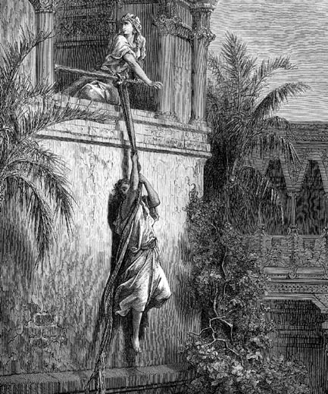
King Saul's oldest daughter I Samuel 14:49; 18:17,19

Slide 29
Merab

Slide 30
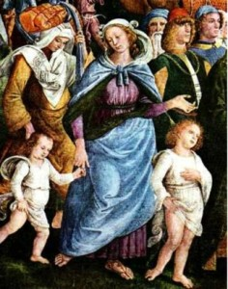
Wife of Moses, daughter of Jethro.

Slide 31

Zipporah

