Slide 1
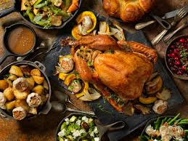
Guess What I Have
Thanksgiving Food Edition

Slide 2
Food Item 1
This gel fruit is served as a side dish.
It can be home made our purchased in a can.
This tart yet refreshing item is a staple for any holiday gathering

Slide 3
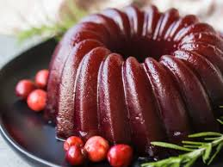
Cranberry Sauce

Slide 4
Food Item 2
A vegetable dish that is mixed with a cream soup.
Many different ways to make this dish
Mmm good

Slide 5
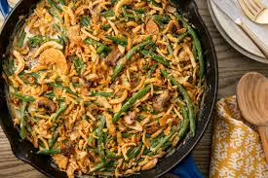
Green Bean Casserole

Slide 6
Food Item 3
There are various ways to make it, but it usually consists of finely chopped breadcrumbs, onions, and herbs that are stuffed inside the turkey and cook with the turkey inside of the oven.
This is usually has a mushy texture, and it takes on a lot of flavor from the turkey.

Slide 7
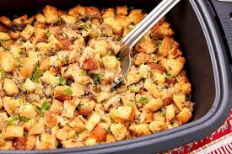
Stuffing

Slide 8
Food Item 4
Originally came from South America, and they had not yet made their way to North America in 1621.
So, although they are now popular at Thanksgiving dinner, they would not have been present at the original feast.
Yukon, Peruvian, russet, and Katahdin are just some types.

Slide 9
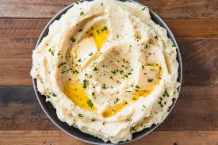
Mashed Potatoes

Slide 10
Food Item 5
A type of bread that is made from a vegetable by product
Golden in color and rich in flavor
Pass the honey and butter for this one.

Slide 11
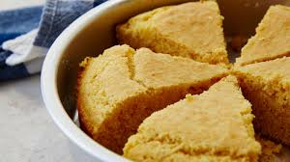
Cornbread

Slide 12
Food Item 6
a brown sauce that we make by adding flour to the juices that come out of the turkey while it is cooking.
Goes over almost everything on the plate.

Slide 13
Gravey

Slide 14
Food Item 7
It’s served as a side dish, not a dessert, but it is very sweet.
These originate in the Caribbean and, like the white verity, they had not yet arrived in North America in 1621.
So many different ways to cut and mash them.
This should shut my mouth.

Slide 15
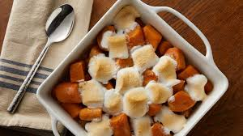
Sweet Potatoes

Slide 16
Food Item 8
Golden nuggets of sweet giblets
This was a crop that the Native Americans taught the Pilgrims how to grow them.
This has a verity of uses for fall foods
Creamed, ground, or canned

Slide 17
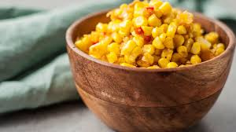
Corn

Slide 18
Food Item 9
At the first Thanksgiving meal, the Pilgrims didn’t have butter or wheat flour, so whatever type of this item they had would have been made out of corn.
This is good to sap up gravy and turkey or other items on your plate.
Thank you Pillsbury for wonderful options

Slide 19
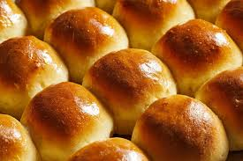
Rolls

Slide 20
Food Item 10
This is a typical Thanksgiving food, and it can be prepared in a variety of ways. It has a soft texture and a sweet flavor.
This is a good type of soup to serve with this meal.
Another gourd for the table

Slide 21
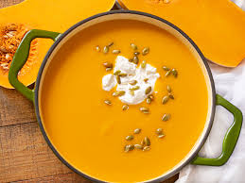
Butternut Squash soup

Slide 22
Food Item 11
Fruit of knowledge makes the cut
Spices create a wonderful scent for the whole house.
Warm and delightful appetizer, side or dessert items to partake in.

Slide 23
Apple Slices

Slide 24
Food Item 12
A refreshing fall beverage that is good either cold or warm
Fruit based drink’s fruit is harvested for many different options
This crisp drink would keep the doctor way.

Slide 25
Apple Cider

Slide 26
Food Item 13
You are out of your gourd if you don’t have this delicious dessert
Take your unused jacks from Halloween and make a sweet treat.
Baked this to make your home smell like a seasonal delight.

Slide 27
Pumpkin Pie

Slide 28
Food Item 14
If you are not a big poultry eater then this would be sitting on your carving station.
Usually it’s a Christmas meat.
The honey glazed is the best!

Slide 29
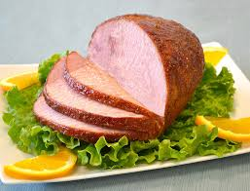
HAM

Slide 30
Food Item 15
No traditional Thanksgiving dinner would be complete without the main meat! In fact, in informal conversation, some people refer to Thanksgiving as this Meat Day.
Roughly 46 million of this Meat product are eaten each year on Thanksgiving. One lucky bird escapes, though, because it is pardoned by the U.S. President!

Slide 31
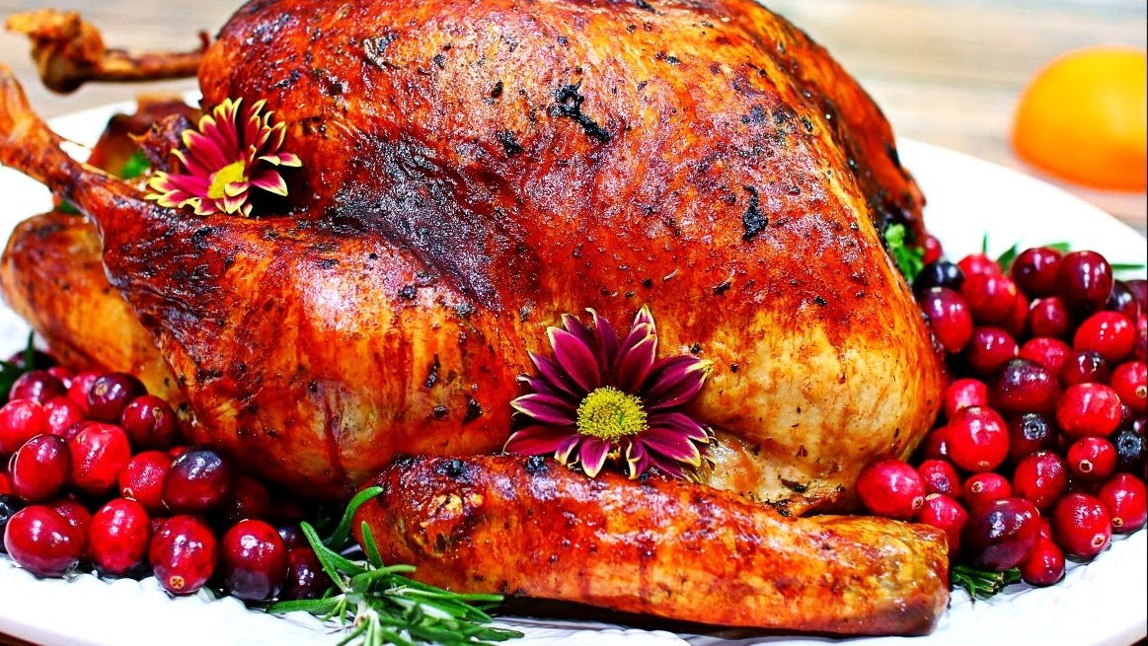
The Turkey

