Slide 1
Guess what it is
Autumn harvest edition

Slide 2
Guess what it is
an unfiltered, unsweetened, non-alcoholic beverage made from a fruit of a tree. t is the liquid extracted from a fruit and all its components, that is then boiled to concentration. The liquid can be extracted from the fruit itself, the core, the trimmings, or the fruit’s culls. It is typically opaque due to fine Fruit particles in suspension and generally tangier than commercial filtered Fruit juice, but this depends on the variety of the fruit used.

Slide 3


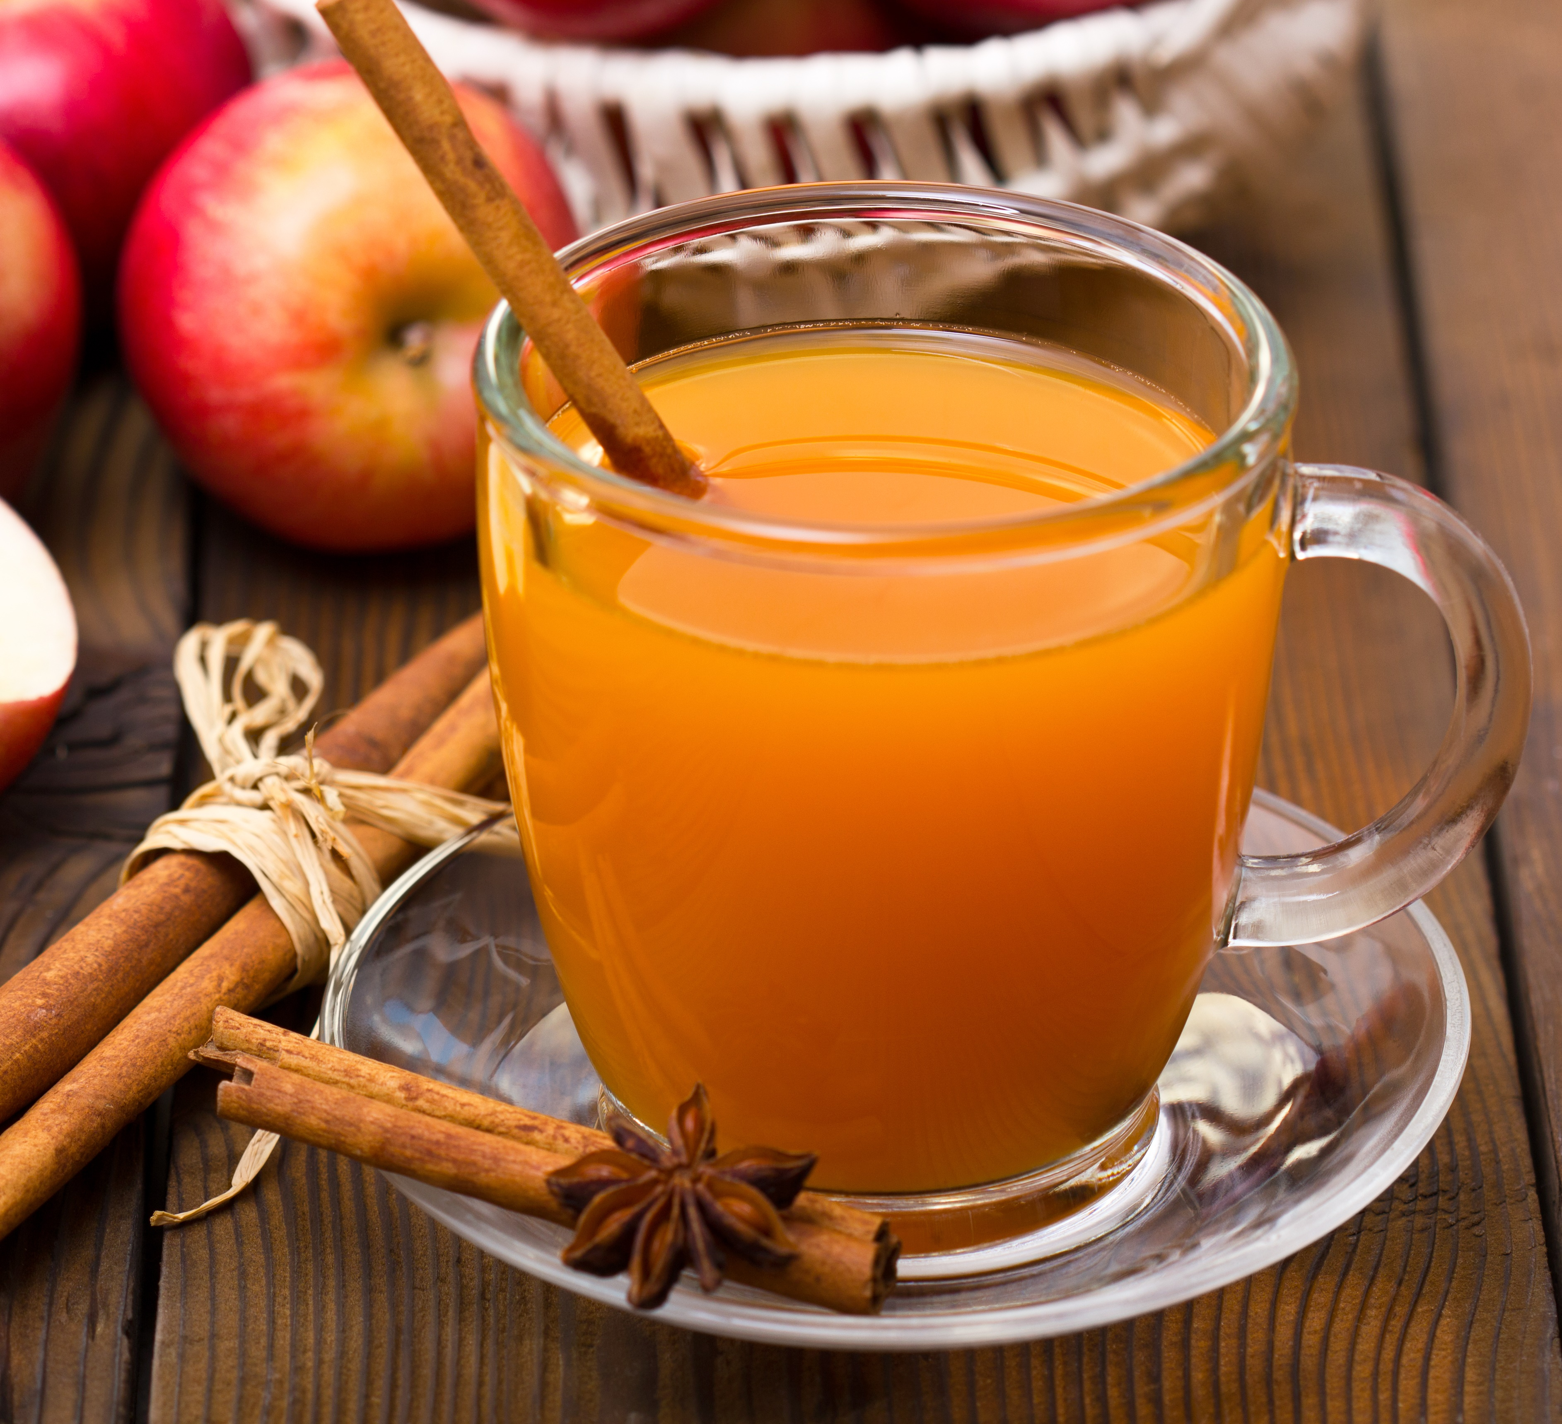
Apple Cider

Slide 4
Guess what it is
originated in northeastern Mexico and southern United States. The oldest evidence were fragments dated between 7,000 and 5,500 BC found in Mexico. The fruits are a type of botanical berry known as a pepo.

Slide 5
PUMPKIN

Slide 6
Guess what it is
are the outer covering of an vegetable. When Commercially bought, they are commonly the whole and are sun, air or oven dried. For most applications, they need to be soaked in hot water in order to become pliable. They are most commonly used to encase foods to be steamed or baked, imparting a very light corn flavor.

Slide 7
Corn Husk

Slide 8
Guess what it is
native to North America, are harvested in New England and the Upper Midwest in the fall. are small, hard, round, red fruits with a flavor that many describe as both bitter and sour. They're related to blueberries and wintergreen.

Slide 9
Cranberries

Slide 10
Guess what it is
are cool-weather crops that come into season in late fall (and last in temperate climates through early spring). They are the crunchy colorful greens with a subtle bitter edge that get us through the winter season. Looking more like flower petals than your average salad greens—they can range from firm pale yellow endive petals to magenta-speckled radicchio leaves and wildly frizzy frisée.

Slide 11
Chicories

Slide 12
Guess what it is
(early fall) it comes into season toward the end of summer, but bright shiny heavy-feeling specimens stay in season well into fall. a plant species in the nightshade family Solanaceae. Solanum melongena is grown worldwide for its edible fruit.

Slide 13
Eggplant

Slide 14
Guess what it is
has a natural season that runs from fall through early spring. Like most cool-weather crops, the plant bolts and turns bitter in warmer weather. is a member of the carrot family, though it's not a root vegetable. The base of its long stalks weave together to form a thick, crisp bulb that grows above ground. Above the bulb, at the tip of the stalks, it has light, feathery leaves that resemble dill.

Slide 15
Fennel

Slide 16
Guess what it is
This is at its best in the cooler months of fall, winter, and early spring (except in cold climates, where you'll find it during the summer and early fall). This is a marshland plant in the family Apiaceous that has been cultivated as a vegetable since antiquity. This vegetable has a long fibrous stalk tapering into leaves. Depending on location and cultivar, either its stalks, leaves or hypocotyl are eaten and used in cooking.

Slide 17
Celery

Slide 18
Guess what it is
This is at its best in fall and winter. Like so many other root vegetables, however, it stores well and is often available in decent shape well into spring. It is a perennial plant of the family Brassicaceae (which also includes mustard, wasabi, broccoli, cabbage, and radish). It is a root vegetable, cultivated and used worldwide as a spice and as a condiment.

Slide 19
Horseradish

Slide 20
Guess what it is
(late fall) comes into season by the end of fall but stays at its sweet best into winter. also known as German turnip or cabbage turnip, is very popular in Northern and Eastern European countries like Germany and Hungary as well as northern Vietnam and eastern India. The funny-looking vegetable is part of the same family as broccoli and cabbage and can be eaten raw or cooked in a variety of dishes.

Slide 21
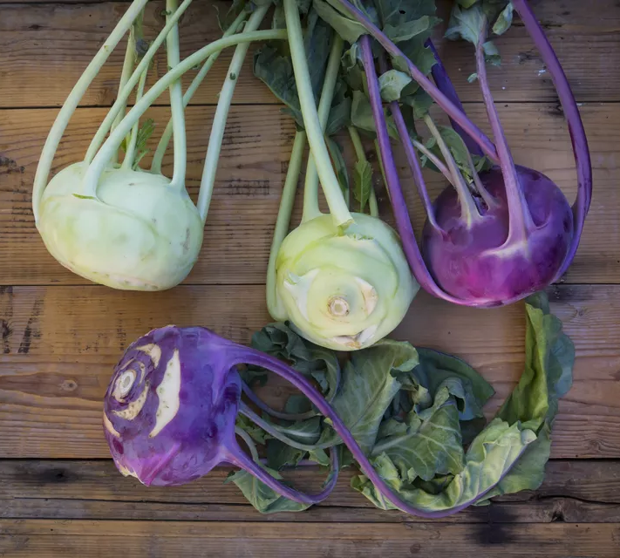
Kohlrabi

